Slide 1

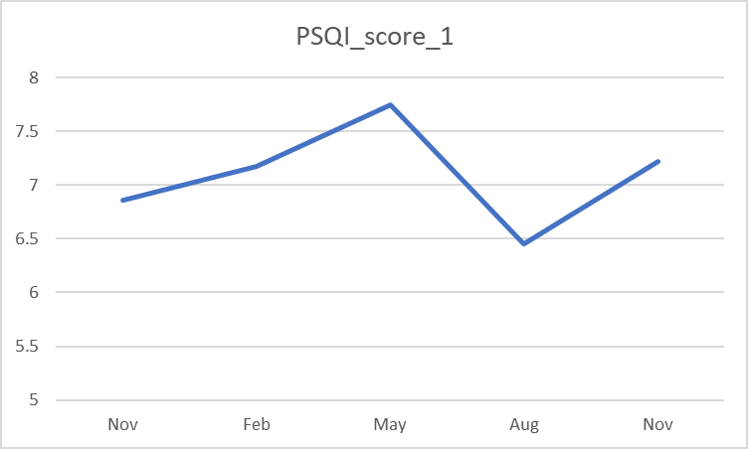
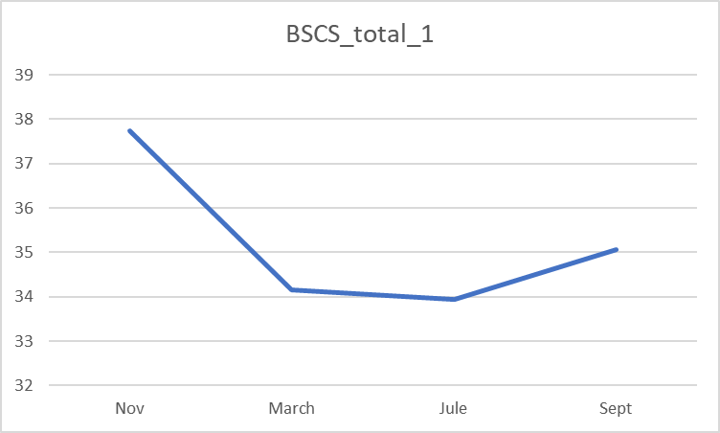
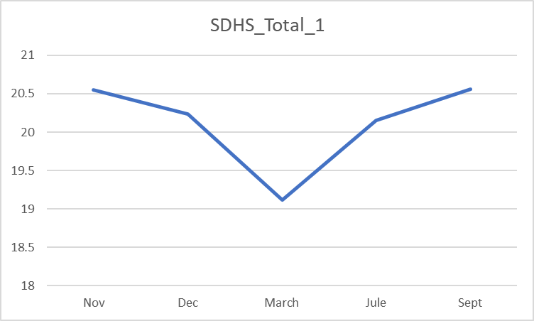
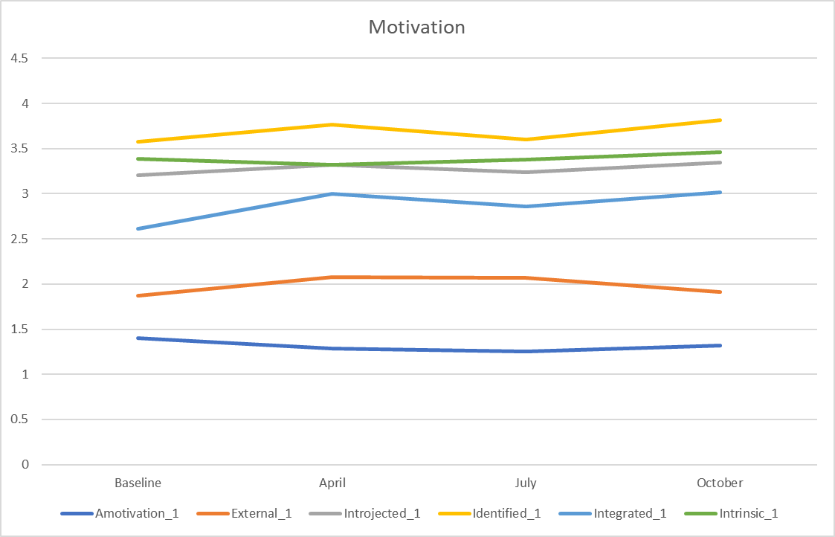
The Impact of Smartwatch Use on Motivation, Self-Regulation, Health and Performance
P279
Dr Richard Steel* & Prof Suvo Mitra
Richard.steel@ntu.ac.uk
INTRODUCTION
RESULTS
Smartwatch technology has been posited as an intervention to increase healthy behaviour
Evidence of short-term (<3 months) benefits.
Long-term data absent or less promising.
Little is known about the psychological mechanisms that underpin health behaviour change in smartwatch users.
Sleep
Summer decrease likely due to seasonal variation
Self-Regulation
Declined after obtaining a Smartwatch
PROBLEM STATEMENT
How do smartwatches impact student healthy behaviour?
What are the predictors of student health, wellbeing and exam performance?
What are the effect of smartwatch use on motivation and self-regulation?
Wellbeing (SDHS)
Mood lowest in March
METHOD
Motivation
Autonomous motivation >> controlled motivation >> amotivation
Integrated and identified motivation Increased over time
Design
12-month longitudinal investigation
Participants
48 female (M_{age} = 22.42) and 15 male (M_{age} = 22.87); 1 non-binary (18 years old)
Psychometric Measures
Motivation (BREQ-3, Markland & Tobin, 2004)
Self-Regulation (SCS, Tangney et al., 2004)
Sleep (PSQI, Buysse et al., 1989)
Well-being (SDHS, Joseph et al., 2000)
Physiological Measures
Body composition
Procedure
Participant issued with a Garmin smartwatch
Body composition measured (start and end)
Questionnaires administered monthly
Increase in muscle mass over 12 months (45.96 v 47.73, p <.001)
Academic performance associated with wellbeing (r = .316, p = .044)
Sleep also associated with wellbeing (r = .454, p = .005)
IMPLICATIONS
Smartwatches may help to increase sleep quality
May also help increase high quality motivation towards exercise
However, they may undermine self-regulation
Future research may wish to investigate the degree to which individuals engage with their smartwatch
REFERENCES
Buysse, D. J., Reynolds III, C. F., Monk, T. H., Berman, S. R., & Kupfer, D. J. (1989). The Pittsburgh Sleep Quality Index: a new instrument for psychiatric practice and research. Psychiatry research, 28(2), 193-213.
Joseph, S., Linley, P. A., Harwood, J., Lewis, C. A., & McCollam, P. (2004). Rapid assessment of well‐being: The short depression‐happiness scale (SDHS). Psychology and psychotherapy: Theory, research and practice, 77(4), 463-478.
Markland, D., & Tobin, V. (2004). A modification to the behavioural regulation in exercise questionnaire to include an assessment of amotivation. Journal of Sport and Exercise Psychology, 26(2), 191-196.
Tangney J. P., Baumeister R. F., Boone A. L. (2004). High self-control predicts good adjustment, less pathology, better grades, and interpersonal success. Journal of Personality, 72, 271-324.

