Slide 1

School of Social Sciences
Students as lecturers; developing skills for graduate roles
Dee Ellidge – Senior Lecturer
Louise Griffiths – Senior Lecturer & Internship Co-Ordinator
Amy Allen – Senior Lecturer
BA (Hons) Health and Social Care

Slide 2
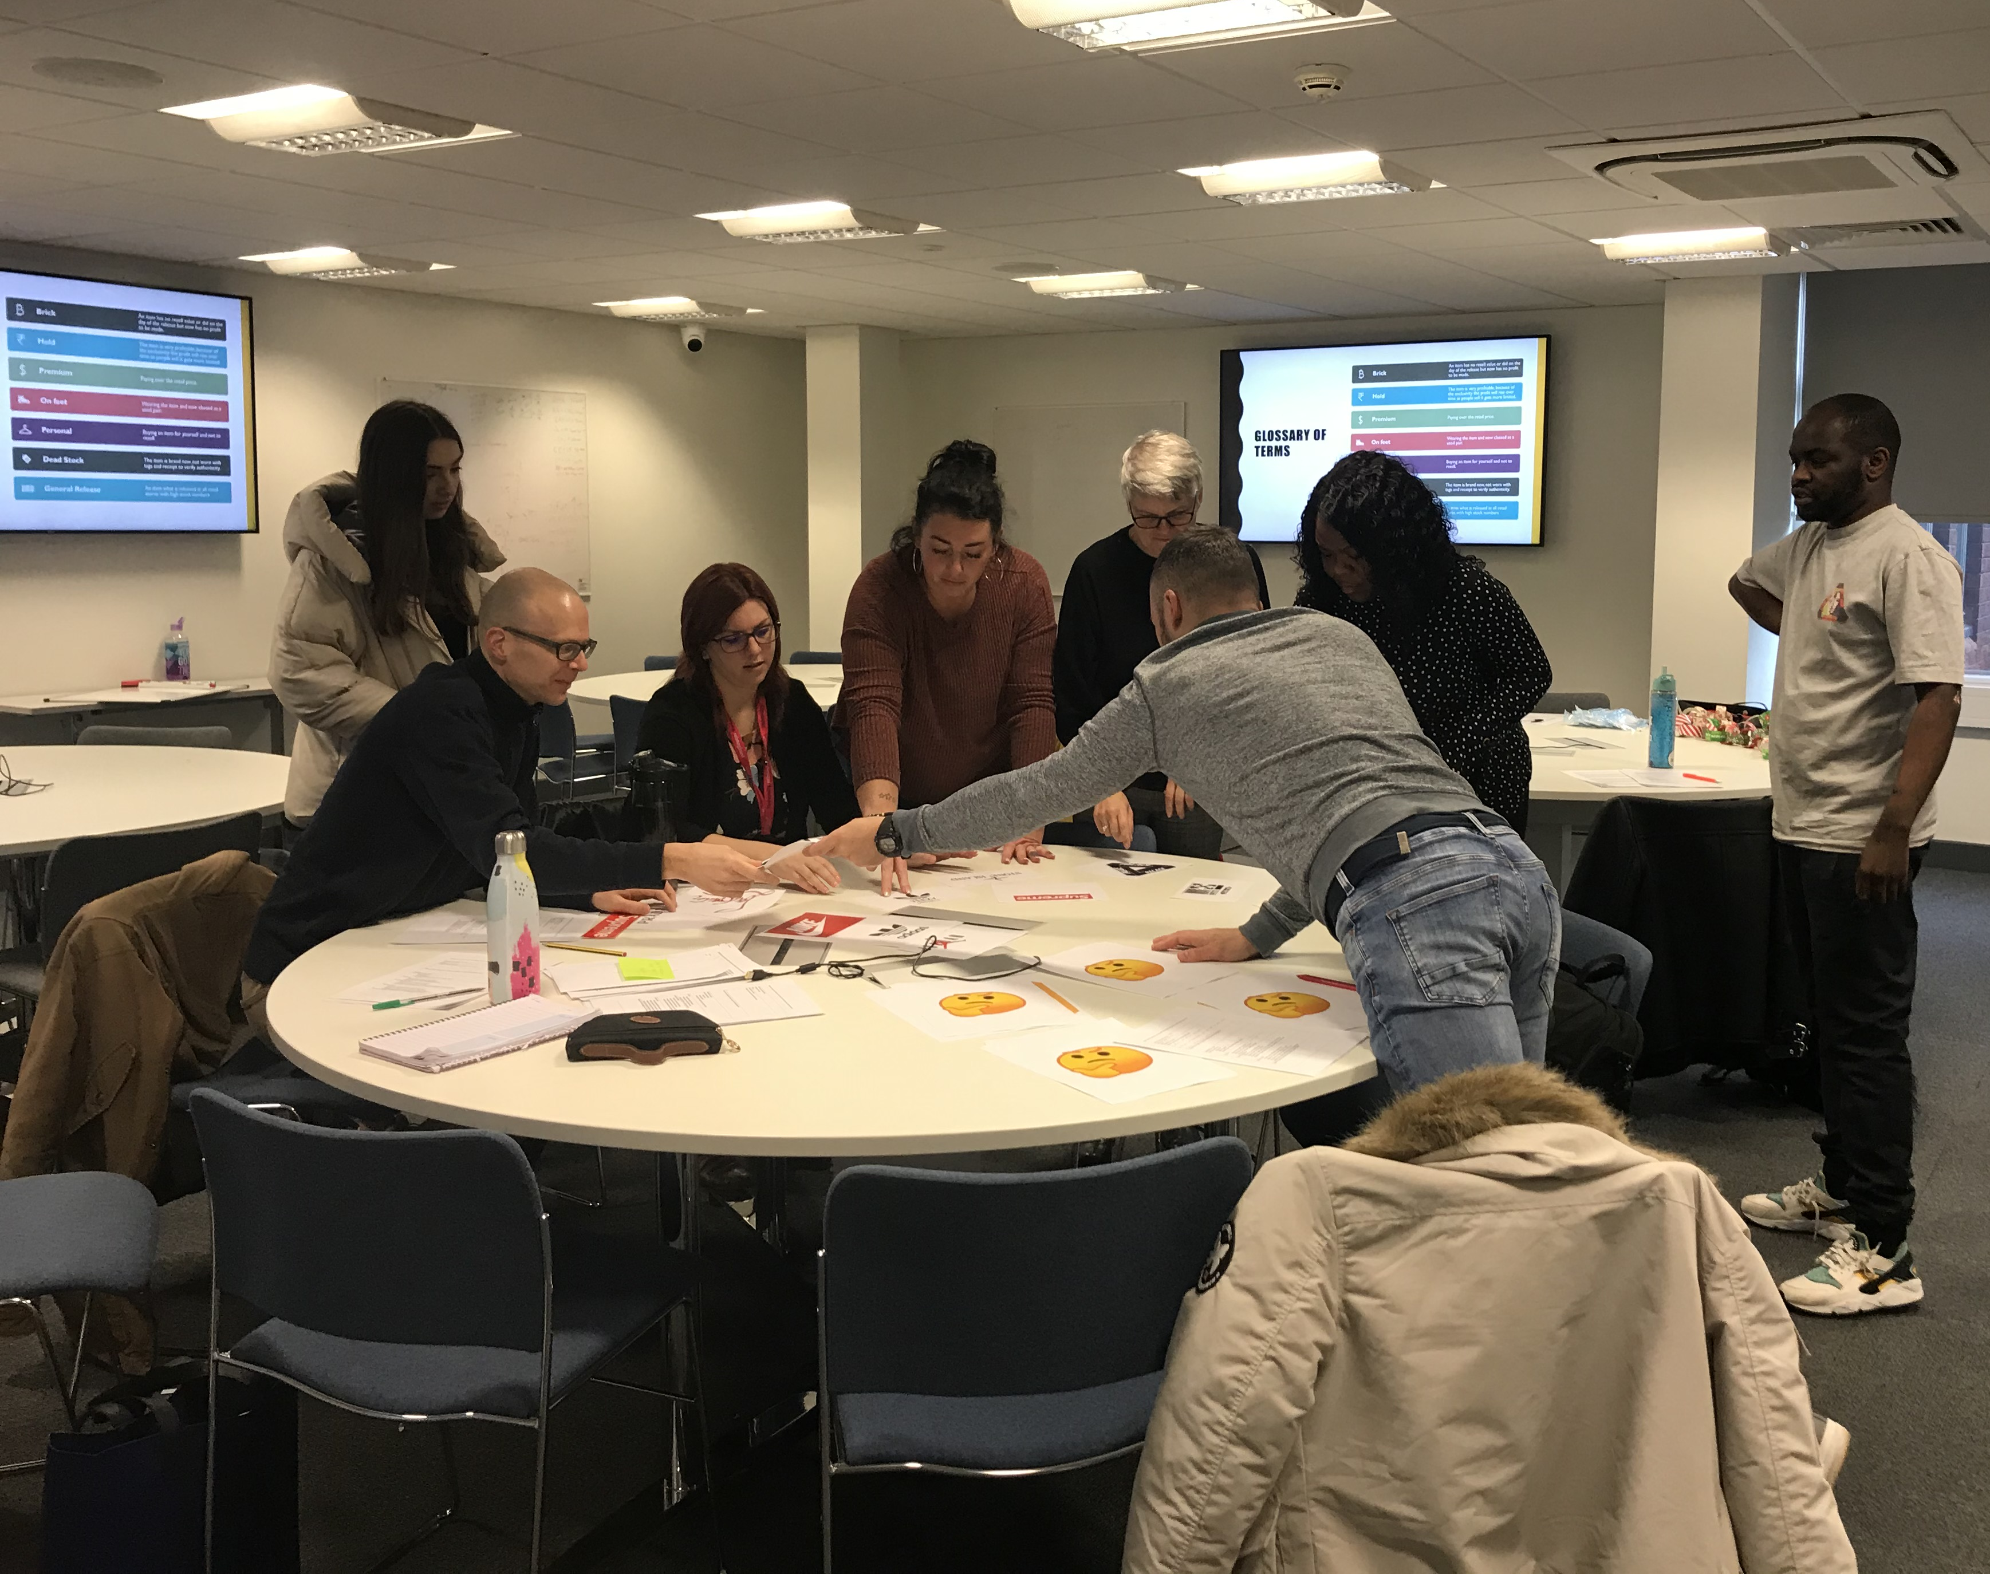
Introduction to the Internship
Outline of the Project
The TRENT Model
Students journey
Lecturer perspective
Key messages going forward

Slide 3
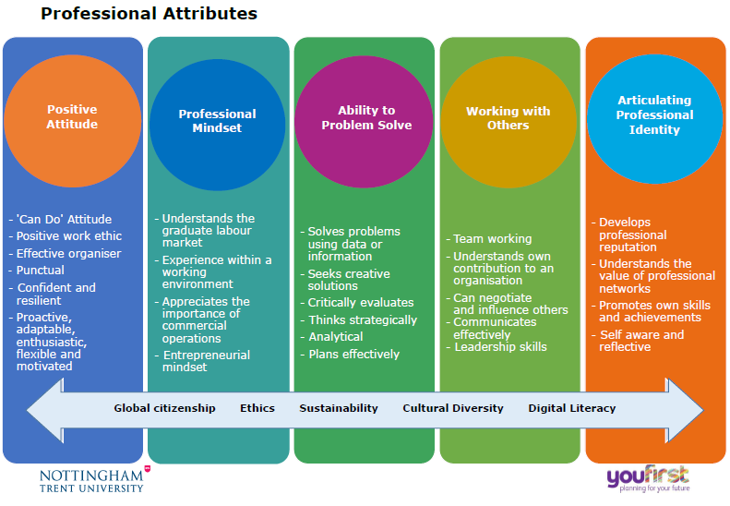
How do students participate in facilitating learning in your institution?
How could this enhance their employability skills on graduation?

Slide 4
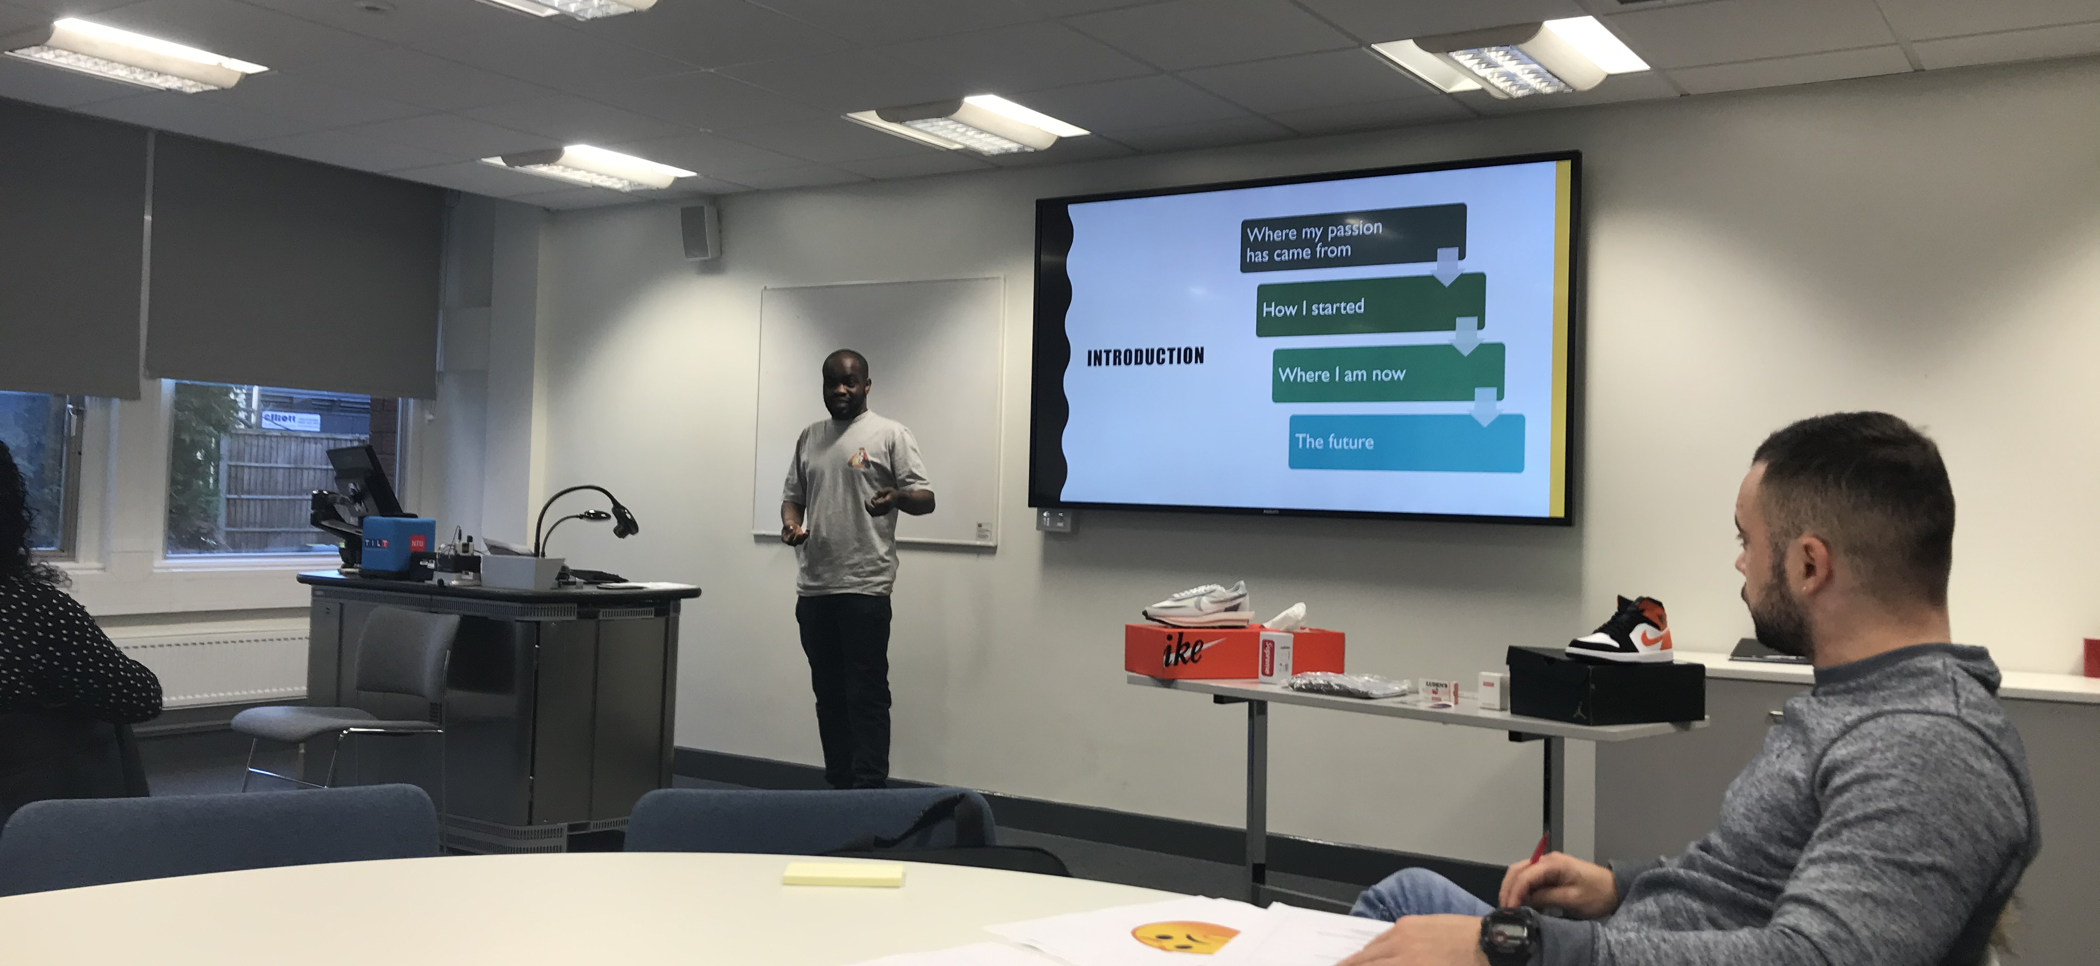
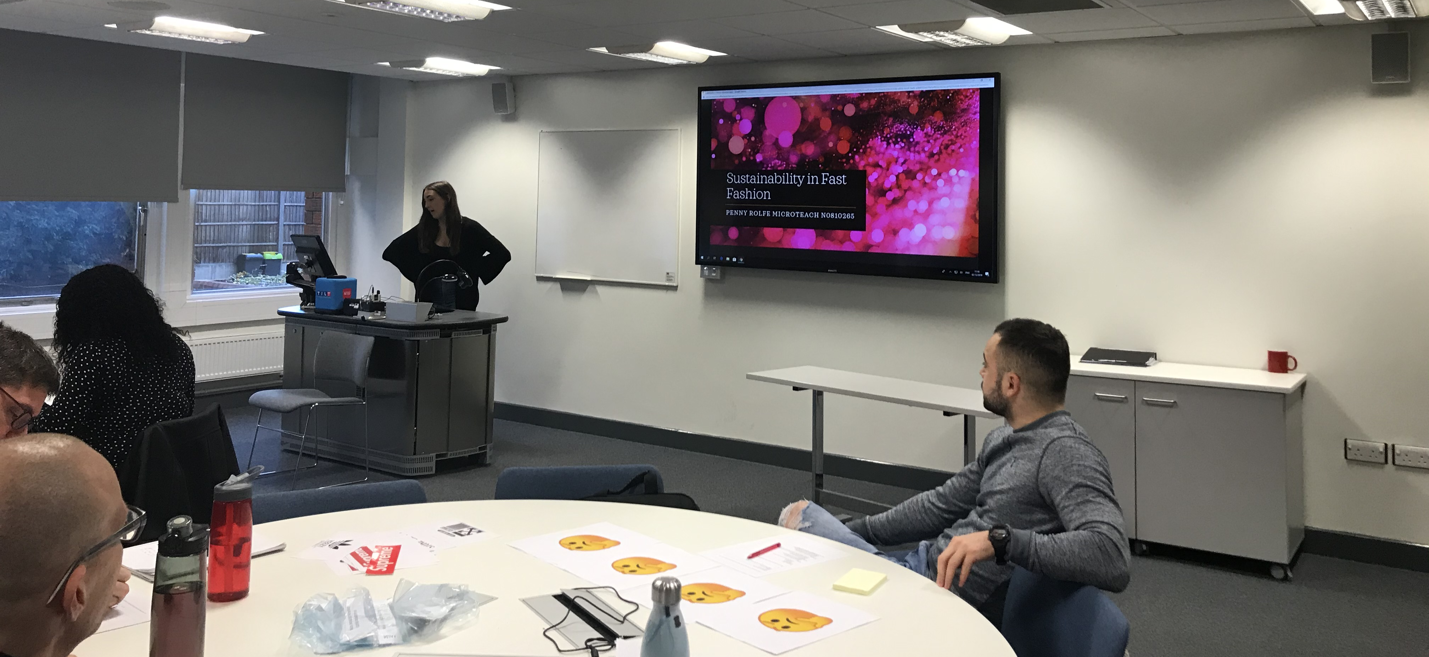
The Internship
Initial idea generated following discussions with a third year Health and Social Care student
Discussions with the course team to see if the idea could be implemented
Planning practicalities- structure, duration, staff and student involvement
Student applications via email
Panel internship interviews
Training needs of students and staff members
Internship induction
Micro-teach
Notes:
As part of my Course Leader role for the Health and Social Care Course I developed and implemented a student teaching and lecturing internship. The initial idea was generated during a discussion between myself and a third year student, who wished to develop purposeful work experience for her future career aspirations as a Lecturer.
The course during this time was required to improve the employability outcomes for the graduates in relation to the DELHE as during this time, the course positive outcomes (The proportion of graduates who were available for employment and had secured employment or further study) had decreased 2016/17 - 87% illustrating a decrease from the previous year 2015/16 - 100% (DELHE, 2018).
In addition, 2016/17 - 27.03% felt they were not well prepared for employment, which is an increase from 2015/16 - 16.67% (DELHE, 2018). As the Course Leader, I also felt the development of the internship also aligned with improving graduate outcomes by providing additional work experience for those students who wish to pursue a career in teaching and lecturing .
To ensure the success of the course internship, I needed to ensure the course team were supportive of the initiative and were willing to dedicate their time to providing this form of work experience to the students on the course. This wasn’t straightforward, as this was a new development this additional time wasn’t built into their allocated workload for the 2018/19 academic year. The course team were really positive and the majority offered to become internship mentors.
The initially implementation of the internship started in January 2019 for six weeks ending on the 5th April. During the application process, the students were asked to identify the modules from the previous year, which they had enjoyed and would like to develop their experience as a Lecturer/Teacher within.
Introduced panel interviews for the internship in the second cohort of interns in September 2019 to increase practical employability skills
The students were then assigned a mentor who was often the module leader for the module the students had selected as of interest from the previous year.
Dee provided the staff with training on how to mentor students
Identified student training needs to be included within the internship induction such as presentation skills, developing learning outcomes/lesson planning and developing a micro teach
Each cohort conducted a micro teach at the end of the internship (15 mins) on a topic of their choice. This was excellent to be part of and the students demonstrated some fantastic presentation skills, lesson planning and innovative topics. This providing the practical skills for future employment.

Slide 5

The TRENT Model
Training
Reflection
Education
Nurturing
Teaching

Slide 6
Our Interns
Outcomes – graduate attributes
Their Journey
Confidence
Communication skills
Knowledge & skills to support study
Insight
Job opportunities
2 Cohorts
10 interns
5 modules / mentors
150 students

Slide 7


Student Voices Dani & Monique (2020)

Slide 8
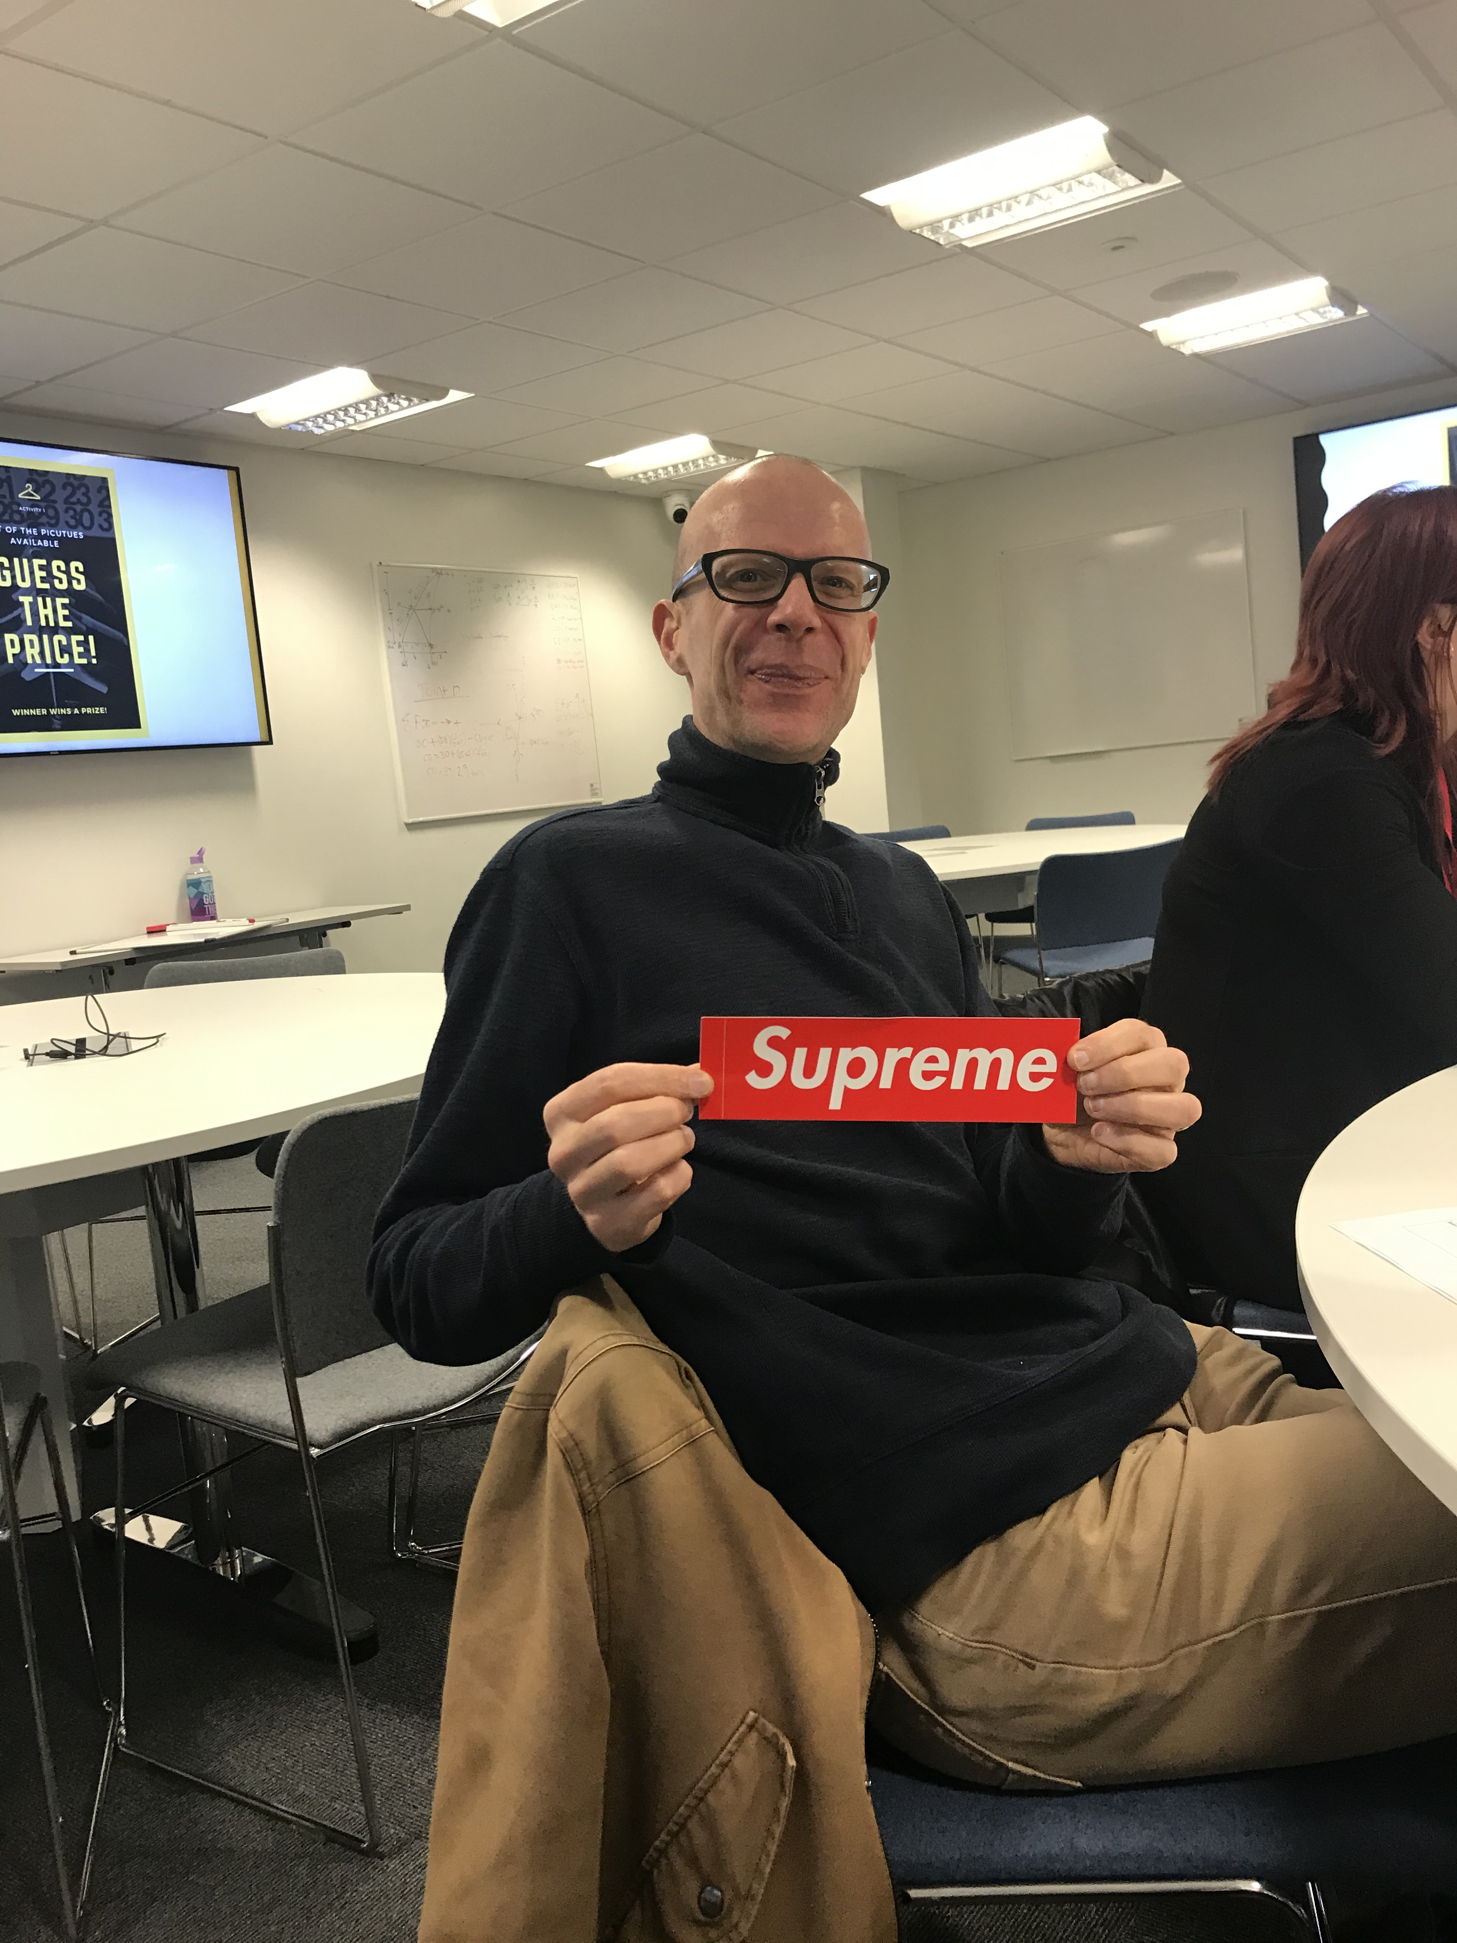
Lecturer Perspective
Opportunities
Challenges
Insight
Reflection
Development
Time
Timetabling

Slide 9

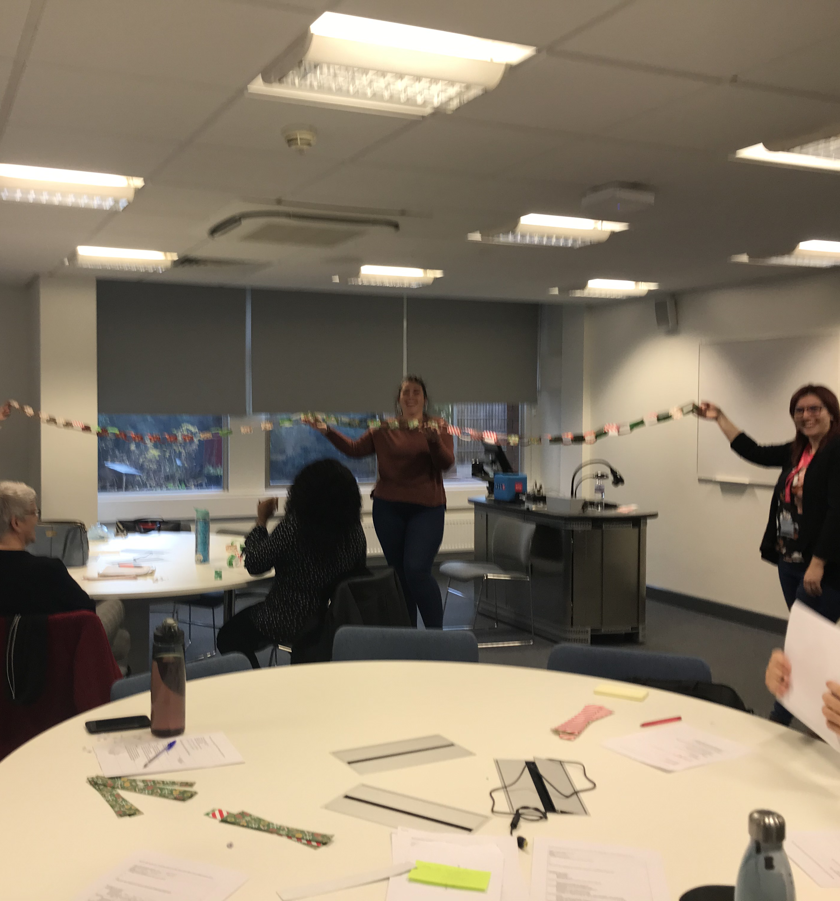
Next Steps
Journal article publication 'The implementation of the TRENT model for course internships’
Dissemination of the TRENT model to other NTU courses, departments and external Universities
Development of an online course internship to take place in October/November 2020
Notes:
LG- Planning is currently taking place to develop an online internship implementing the TRENT model.

Slide 10

dolores.ellidge@ntu.ac.uk
louise.Griffiths@ntu.ac.uk
amy.allen02@ntu.ac.uk

Slide 11
References
Binder, J., H. Baguley, T., Crook, C. and Miller, F. (2015) The academic value of internships: benefits across disciplines and student backgrounds, Contemporary Educational Psychology, 41; 73 -82, https://doi.org/10.1016/j.cedpsych.2014.12.001 [Accessed 27 February 2020]
McGill I. and Brockbank A. 2004. The Action Learning Handbook London, Routledge Falmer

