Slide 1
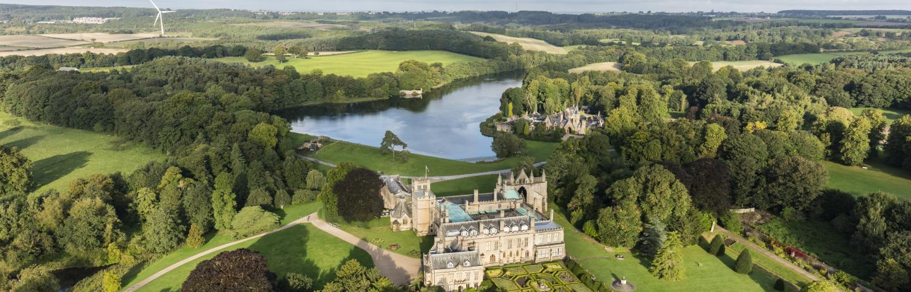

Beeston and District Civic Society
Devolution and Local Government Reorganisation
Audience with Professor Peter Murphy

Slide 2
English Devolution and Community Empowerment Bill formerly called The “Devolution and Local Government Reorganisation Bill”
4 parts to the Bill
Proposes a new system for Local Public Audit in England
More powers to local communities to purchase assets of community value and making reforms to commercial leases.
Devolves Powers from central to local government via elected Mayors and Combined Authorities
Re-organises local government in two tier areas of government into a single unitary tier (Reconfiguration of existing structures and responsibilities)

Slide 3
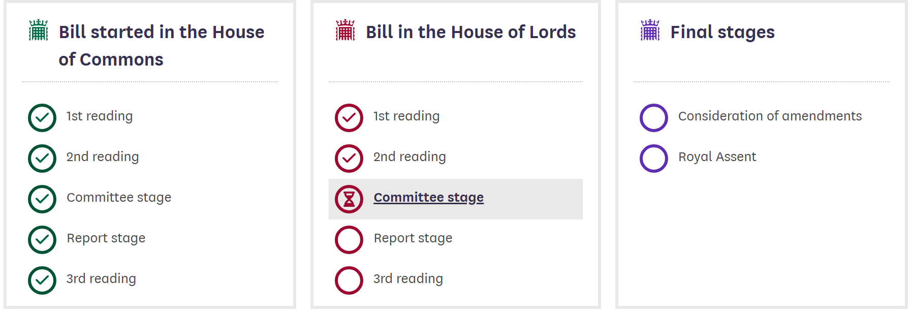
Parliamentary Progress
Introduced 10th July 2025 Transferred 27th November 2025 Gov’t anticipates by May 2026
Committee Stage 20th Jan 2026 Elections May 2027

Slide 4
Existing Combined Authorities
Result from a deals-based approach producing a range of settlements from East Midlands Combined County Authority (Aug 2024) to the Greater Manchester (Nov 2014 with extensions in 2015 (x2); 2016; 2017; 2023).
EMCCA: deal includes Transport Integration, Local Skills Provision and £38m over 30 years for homes on brownfield land and net zero and local housing priorities.
Greater Manchester: devolved and consolidated transport budget; strategic planning powers; £300m housing investment fund; Devolved business support budgets; apprenticeship grants; powers to reshape FE; PCC powers etc plus integration of health and social care across Greater Manchester.
Details on all deals available at
Devolution deals | Local Government Association

Slide 5
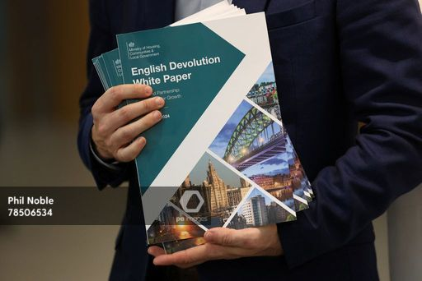
Devolution by default via a standardized framework
A standardised set of legal powers, funding commitments, and partnership/collaboration arrangements with government.
It sets out what Strategic Authorities are entitled to at each level of devolution and automatically gives them the powers.
The bill also
allows expansion of the framework through secondary legislation
allows piloting of specific powers in specific authorities
enshrines a right to request further powers, funding or collaborations

Slide 6

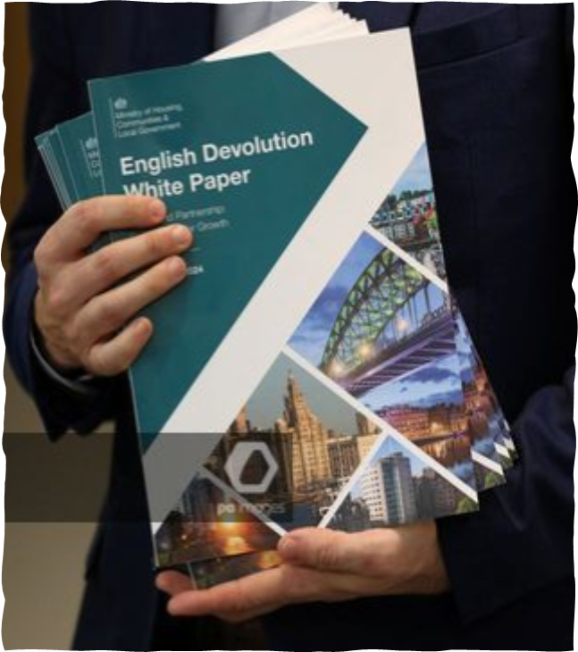
Strategic Authorities “will make it quicker and easier to devolve powers from Westminster to local government”
The Bill establishes the concept of a Strategic Authority (SA) in law and defines them as either:
Foundation SA (including single council devolution deals, and all non-mayoral Combined Authorities and Combined County Authorities).
Mayoral SA (including all mayoral Combined Authorities and Combined County Authorities).
Established Mayoral SA (including the Greater London Authority).

Slide 7
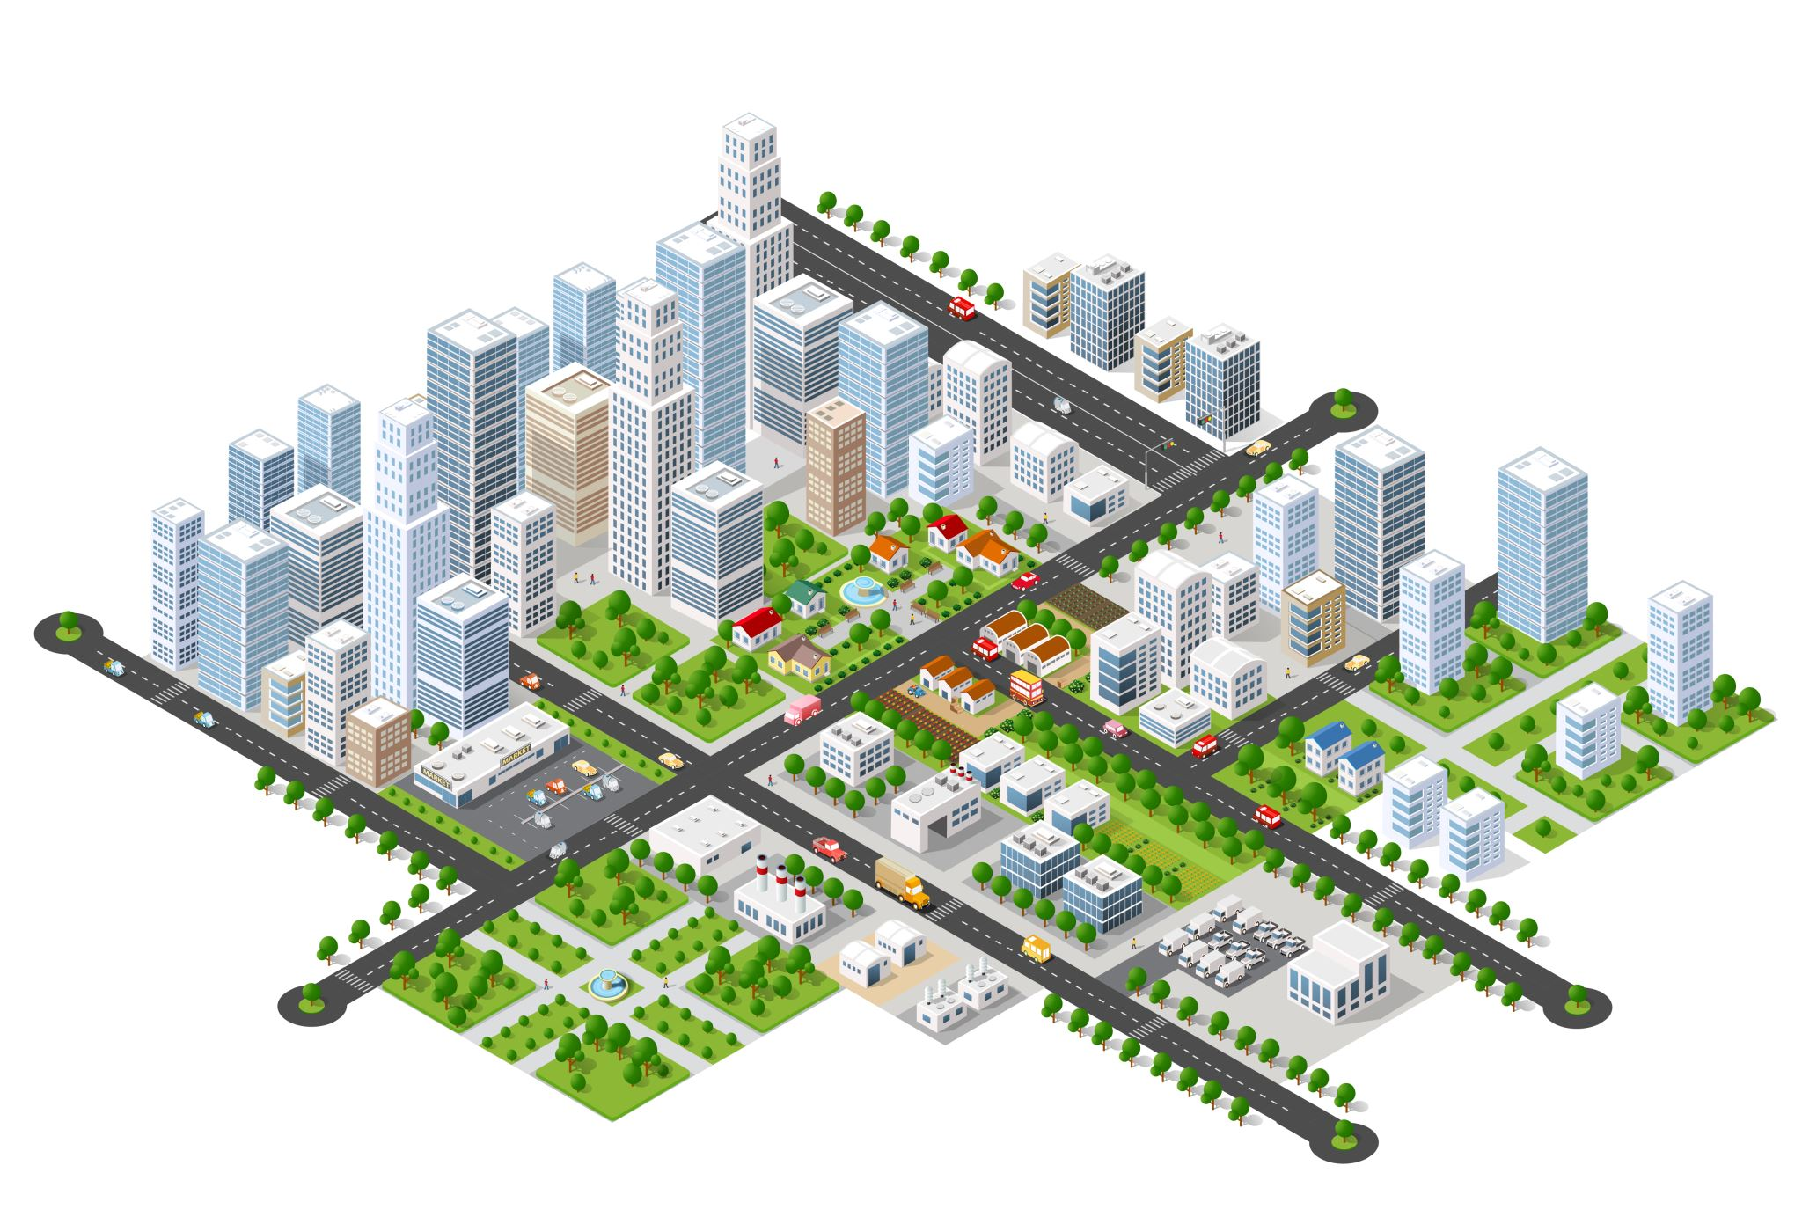
Strategic Authorities – Areas of competence They will perform functions in the following areas
Transport and local infrastructure
Skills and employment support (adult education functions from central government).
Housing and strategic planning (powers similar to Mayor of London plus MDOs).
Economic development and regeneration (local growth plans).
Environment and net zero (leadership role)
Health, wellbeing and public service reform (minimise impact on the health of the people as well as any impact increasing health inequalities).
Public safety (increasing the number of mayors with PCC and PFCC responsibilities)
Details available at: https://www.gov.uk/government/publications/english-devolution-and-community-empowerment-bill

Slide 8
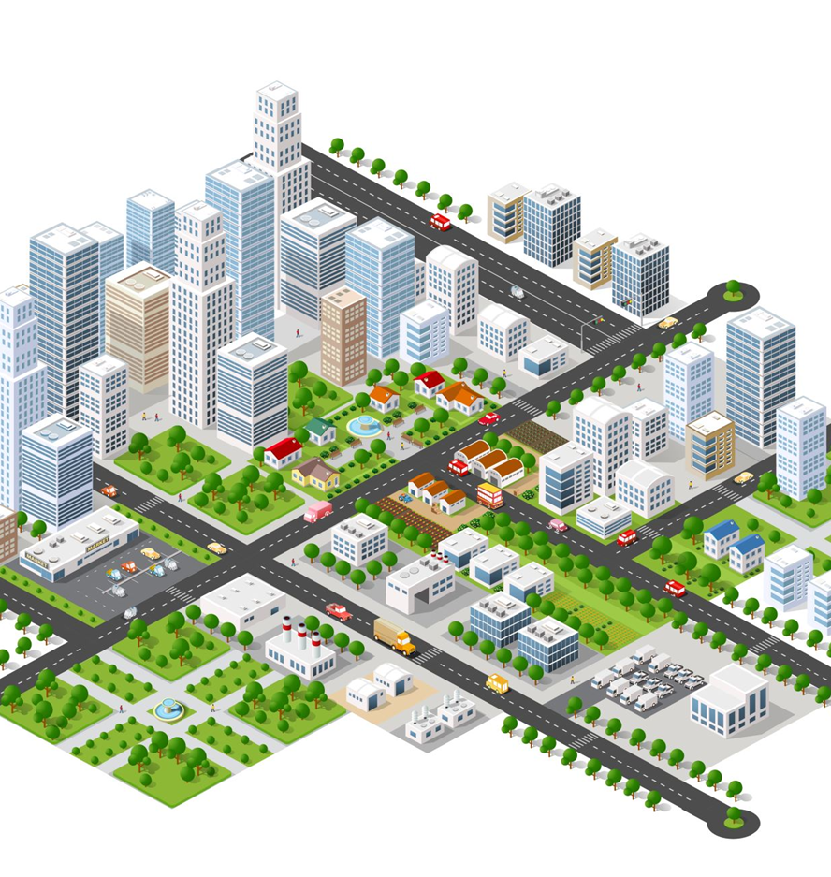
Mayoral Powers of Competence
The General Power of Competence – a broad general power enabling Mayors, to do anything an individual can legally do
A power to convene – enabling Mayors to convene local partners (defined in regulations) to address local challenges
A duty to respond – placing a duty on local partners to respond to a Mayor’s request when they make use of the power to convene
A duty to collaborate – ensuring that Mayors have a formal process by which they can collaborate with neighbouring Mayors to deliver projects and strategies together

Slide 9

Other government initiatives that support devolution
Spending Review – In addition to Greater Manchester and the West Midlands – London, Liverpool (City Region), S. Yorks, the North East and West Yorks to receive integrated financial settlements from 2026/27
Created 4 new Strategic Authorities (Lancashire, Greater Lincolnshire, Hull/E Yorks Devon/Torbay
Devolved Adult Skills functions to the East Midlands, York and N Yorks and Cornwall
Universal Spatial Development Strategies
Devolution Priority Programme and Local Government Reorganisation

Slide 10
Principles guiding future devolution
Scale: Of comparable size to existing institutions. (Default a population of 1.5m+)
Economies: Must focus on functional economic areas.
Contiguity: Geography must be contiguous across constituent councils.
No ‘devolution islands’: Must not leave any areas alone.
Delivery: Should ensure effective delivery of key functions and strategies.
Alignment with other public sector boundaries.
Identity: plays a key role in the ability for residents to engage/hold institutions to account.
Governance: The government has a strong preference for mayoral devolution.

Slide 11
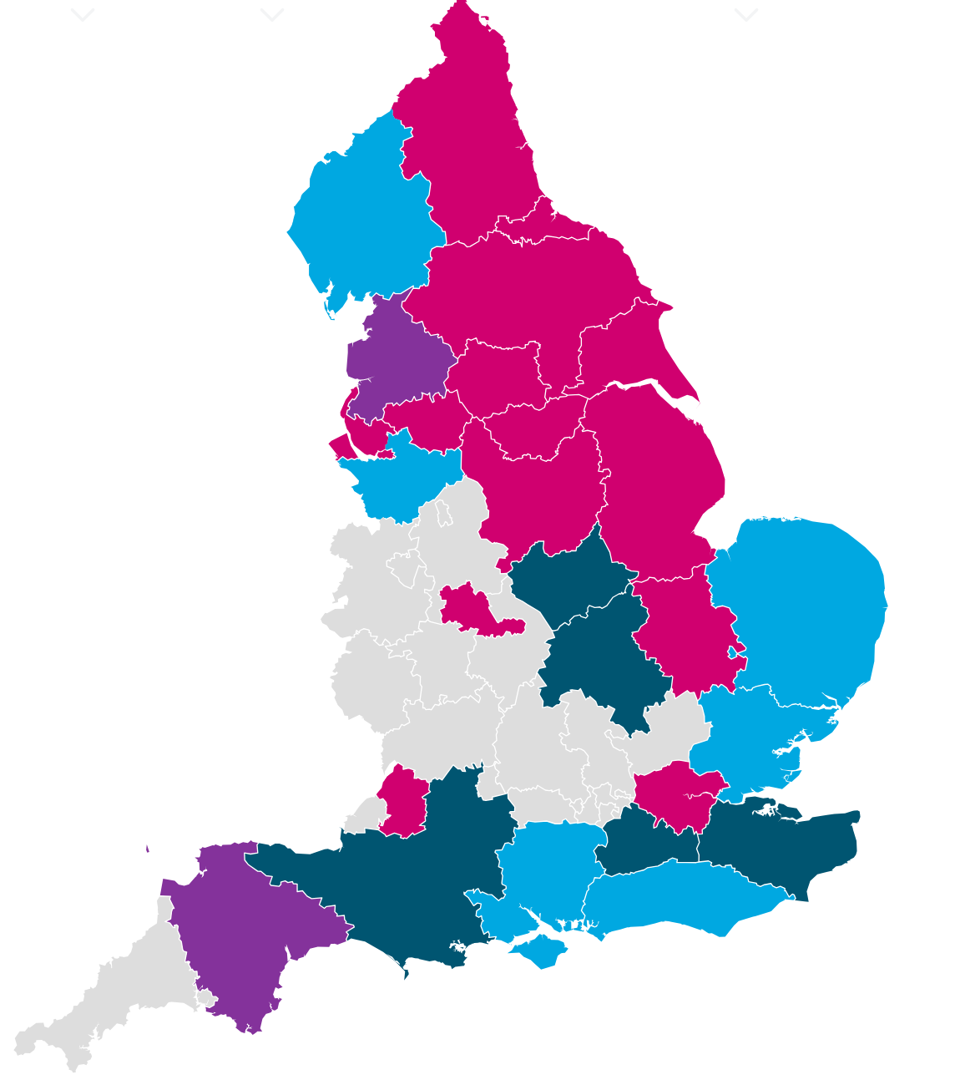
Current devolutions and the Devolution Priority Programme
Existing mayoral devolution
Non-mayoral devolution
Devolution Priority Programme
Unsuccessful DPP application

Slide 12

Devolution Priority Programme (Areas wishing to devolve “at pace” and establish Mayoral Strategic Authorities)
Cumbria (Cumberland Council, Westmorland and Furness Council)
Cheshire and Warrington (Cheshire East Council, Cheshire West and Chester Council, Warrington Borough Council)
Greater Essex (Essex County Council, Thurrock Council, Southend-on-Sea City Council)
Hampshire and Solent (Hampshire County Council, Portsmouth City Council, Isle of Wight Council, Southampton City Council)
Norfolk and Suffolk (Norfolk County Council, Suffolk County Council)
Sussex and Brighton (East Sussex County Council, West Sussex County Council, Brighton and Hove City Council).
Unsuccessful applicants include Leicestershire (LLR); South Midlands (including North and West Northamptonshire)

Slide 13

Cumbria
2 existing unitary’ s
In October 2025 both consented to a CCA with a Mayor in 2027
Cheshire & Warrington
3 existing unitary’ s
In September 2025 all consented to a CCA with a Mayor in 2027

Slide 14

The latest consultations on the remaining DPP (All close on 11th January 2026)
Proposals are grouped to allow all interested parties in the SA area to comment on all proposals, i.e. shared consultation documents covering all proposals in each of:
Essex, Southend on Sea, and Thurrock
Hampshire, Portsmouth, Southampton, and the Isle of Wight
Norfolk and Suffolk
East Sussex, Brighton & Hove, and West Sussex

Slide 15
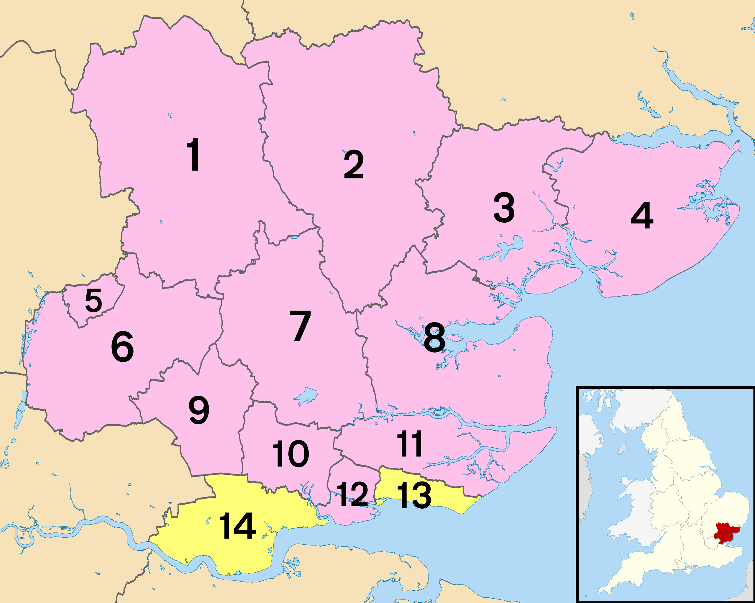
Essex SA– consulting on 4 options (3, 5 and two 4s)
Essex CC – 3-unitary option (1,2,3 & 4), (5,6,7,8 & 9), (10,11,12,13 & 14)
Southend-on-Sea City - 5-unitary option
(11, 12 & 13), (10 & 14), (1,5 & 6), (7,8 & 9) (2,3 & 4)
Thurrock – 4-unitary option (5,6,9 &14), (10,11,12, & 13), (1,2, & 7), (3,4, 7 & 8),
Rochford – 4-unitary option (1,5 &6), (10,12,13 & 14), (7,8,9 &11), (2,3 & 4).
All options use exiting boundaries
1. Uttlesford
2. Braintree
3. Colchester
4. Tendring
5. Harlow
6. Epping Forest
7. Chelmsford
8. Maldon
9. Brentwood
10. Basildon
11. Rochford
12. Castle Point
13. Southend-on-Sea (unitary)
14. Thurrock (unitary)

Slide 16
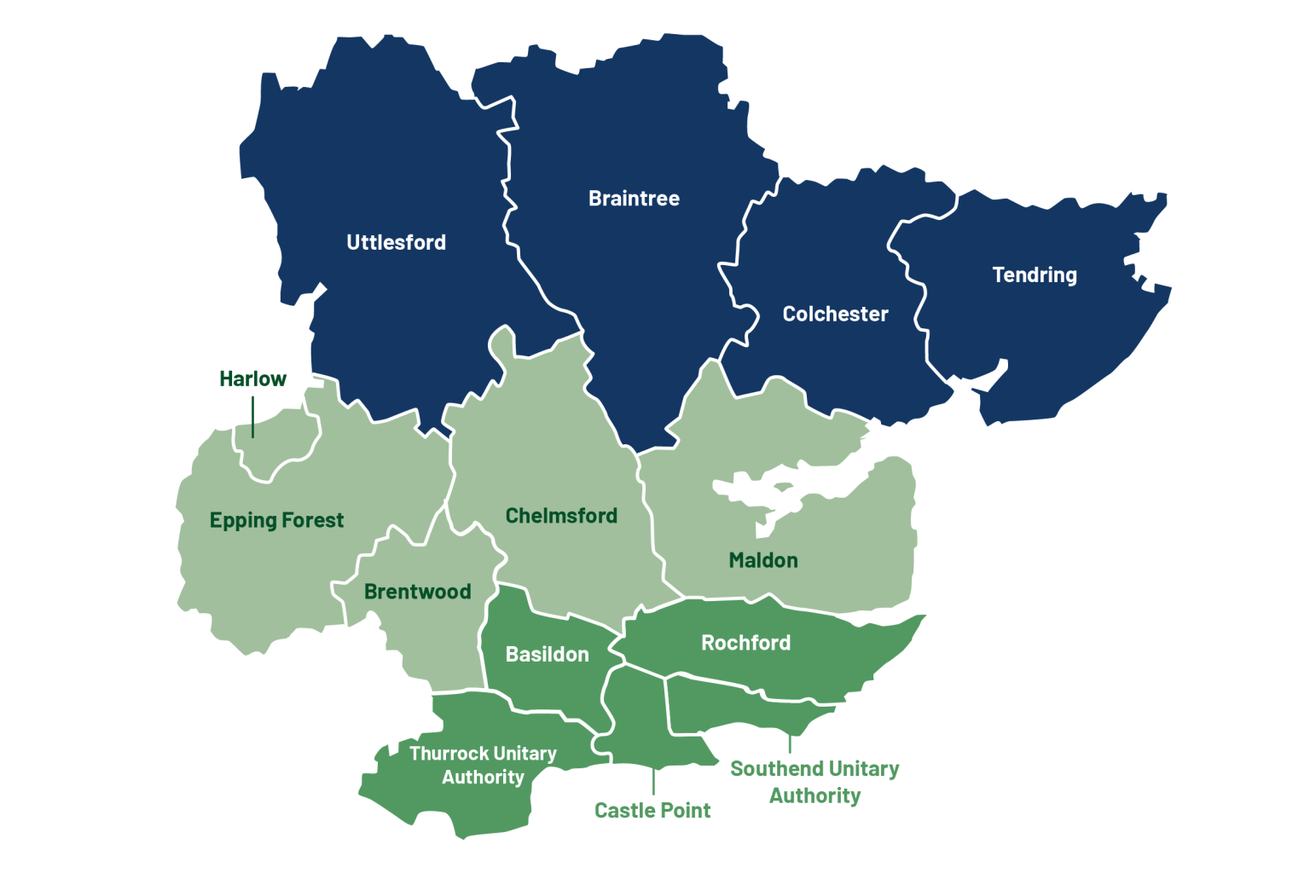
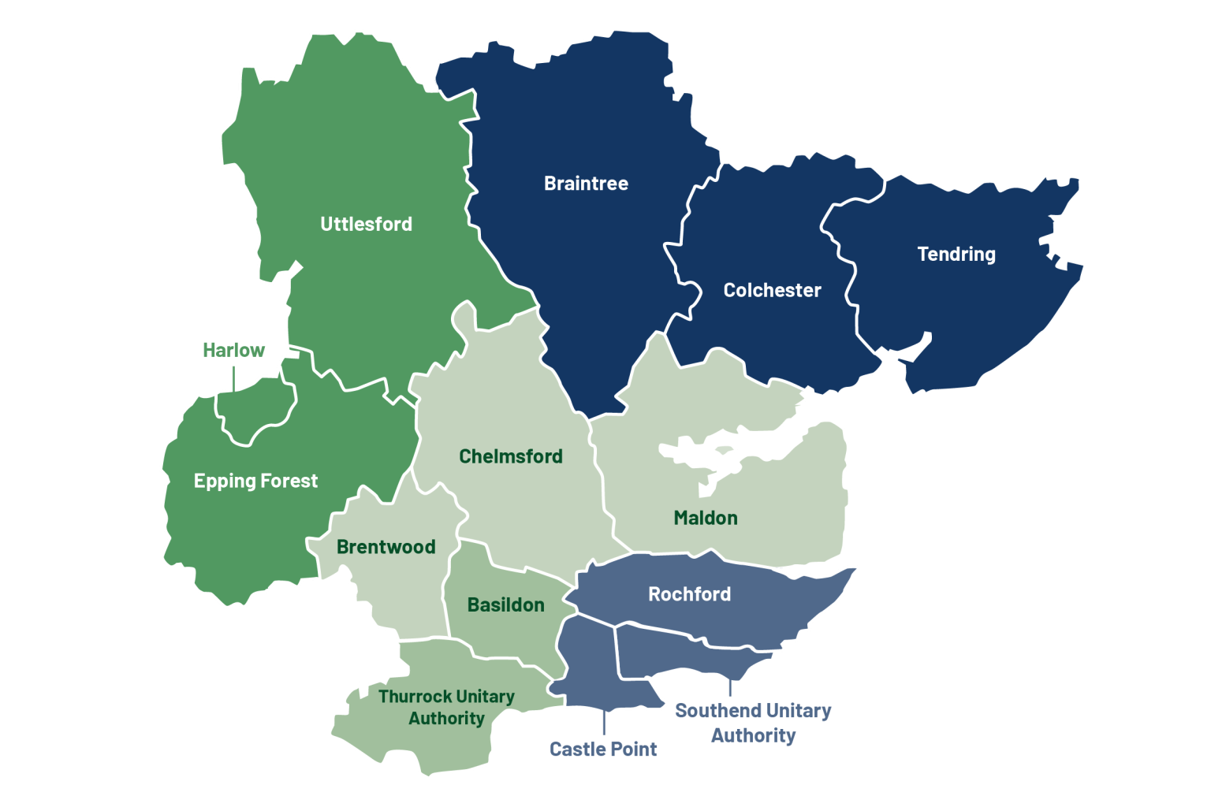
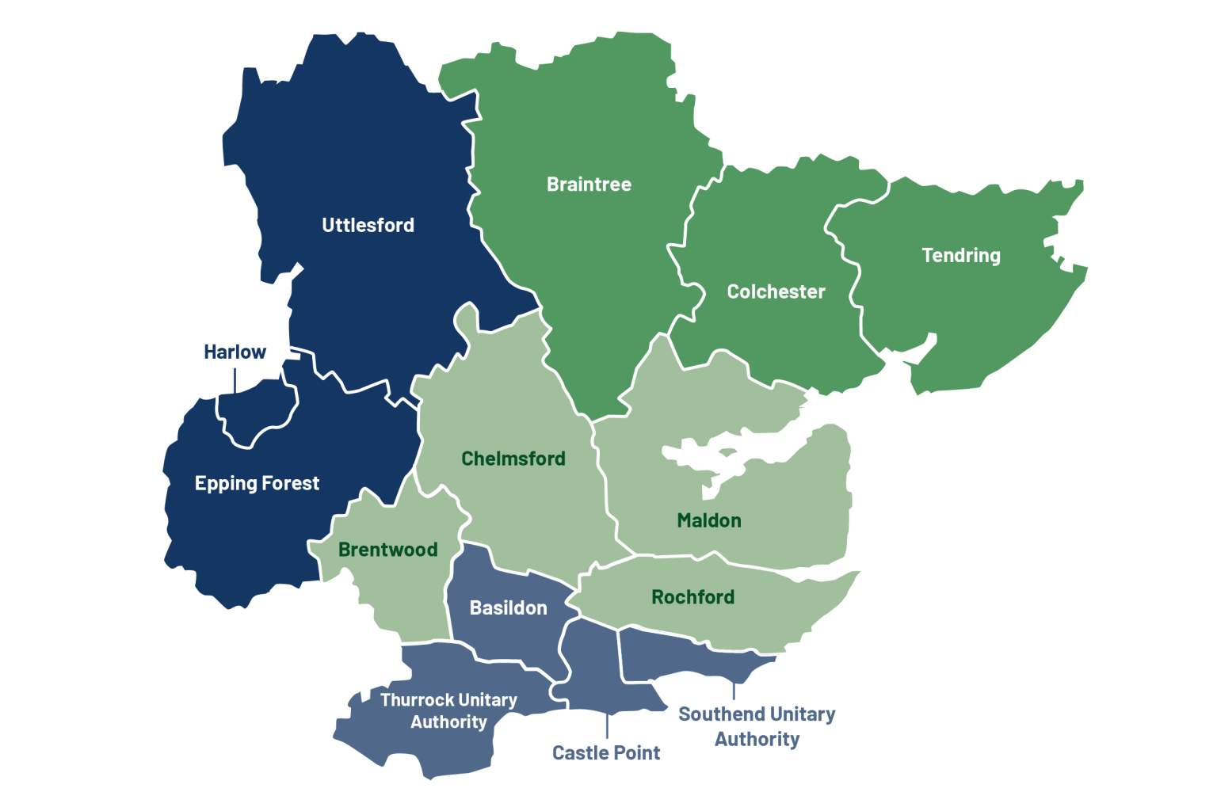
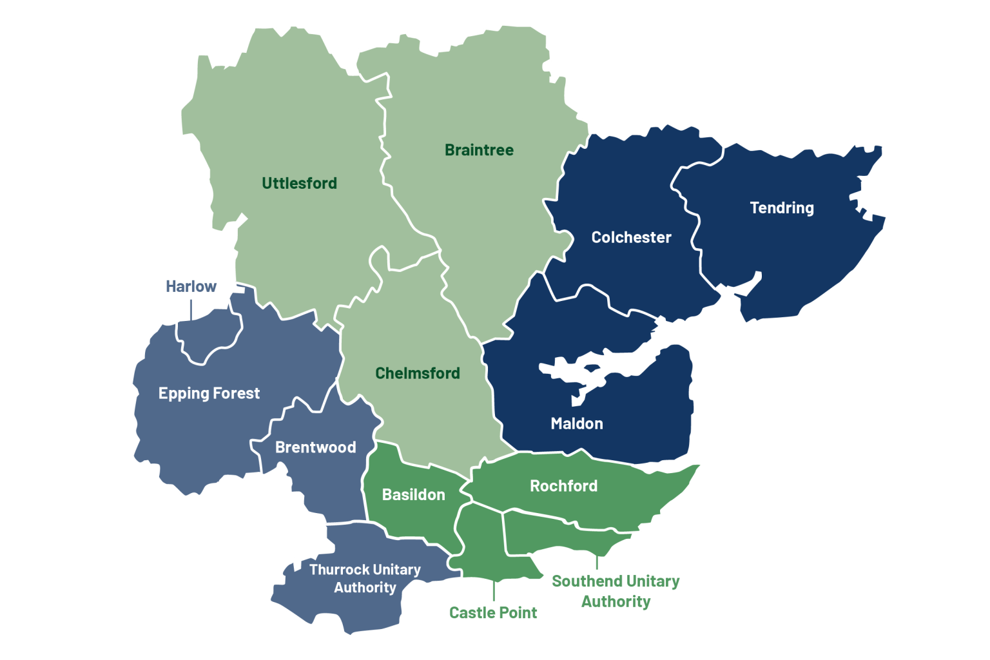

Slide 17
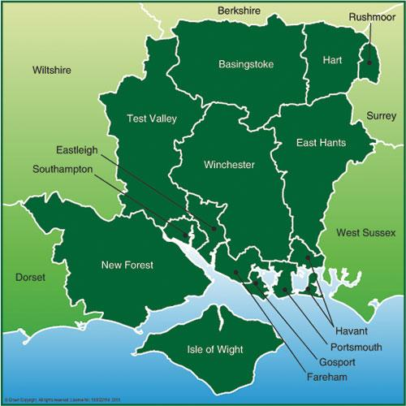
Hampshire/Isle of Wight - 4 options - a 4-council and 3 with 5 councils (all with a unitary IoW)
(2,3 & 4), (1,5,6 & 7), (8 & 9), (10,11,12 &13), (14)
(2,3 & 4), (1,5 & 6), (7,8 & 9), (10,11,12 & 13), (14).
(2,3 & 4), (1,5,6 & 7), (1, 7,8 & 9) (5, 6, 10,11,12 & 13), (14).
(2,3 & 4), (1,5, & 6), (10,11,12 & 13), (14).
NB Districts 1 and 7 are split in option 2 and 6 is split in option 3.
Test Valley
Basingstoke and Deane
Hart
Rushmoor
City of Winchester
East Hampshire
New Forest
Southampton (unitary)
Eastleigh
Fareham
Gosport
Portsmouth (unitary)
Havant
Isle of wight (unitary)

Slide 18
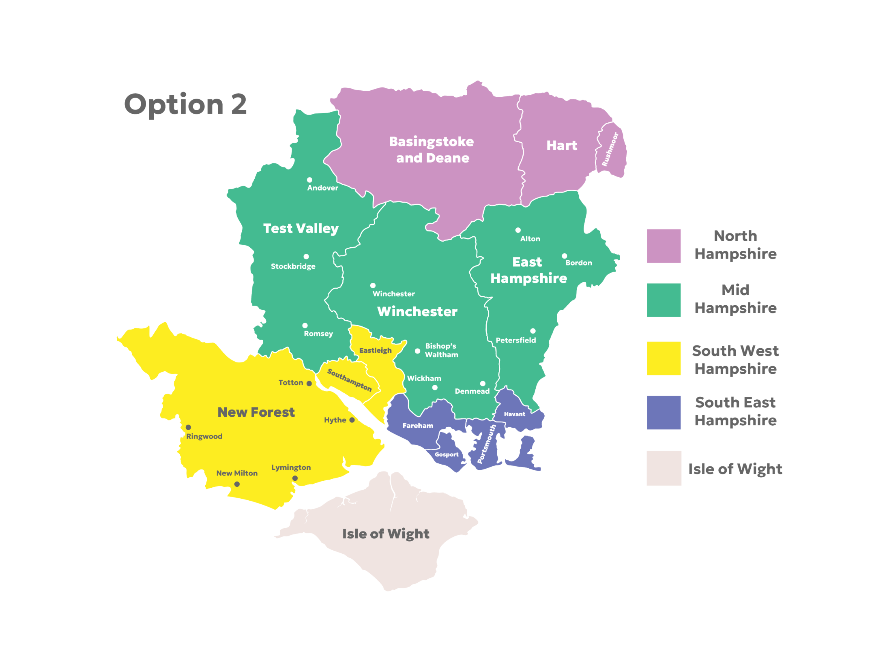
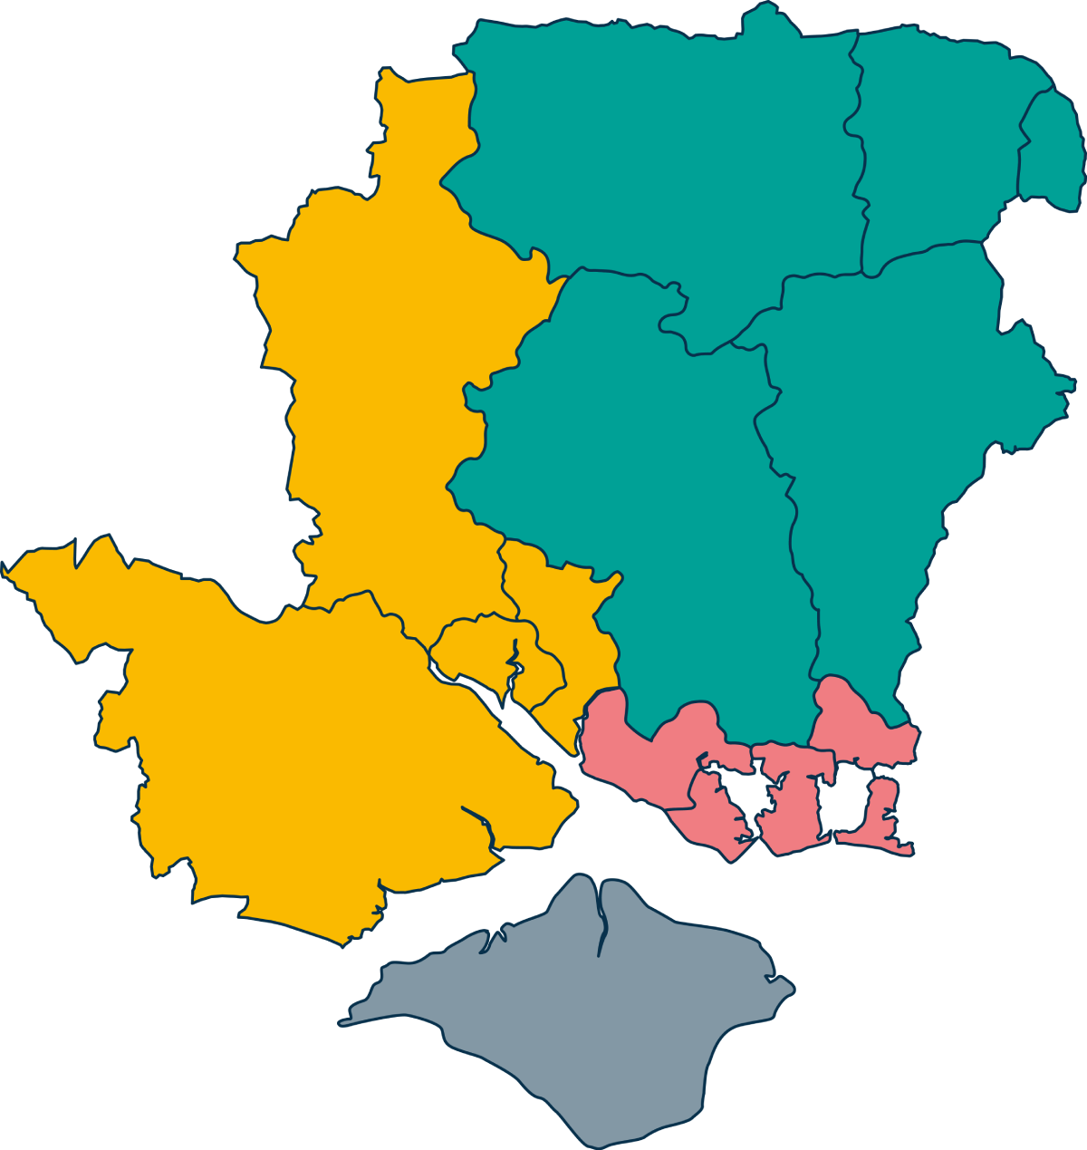
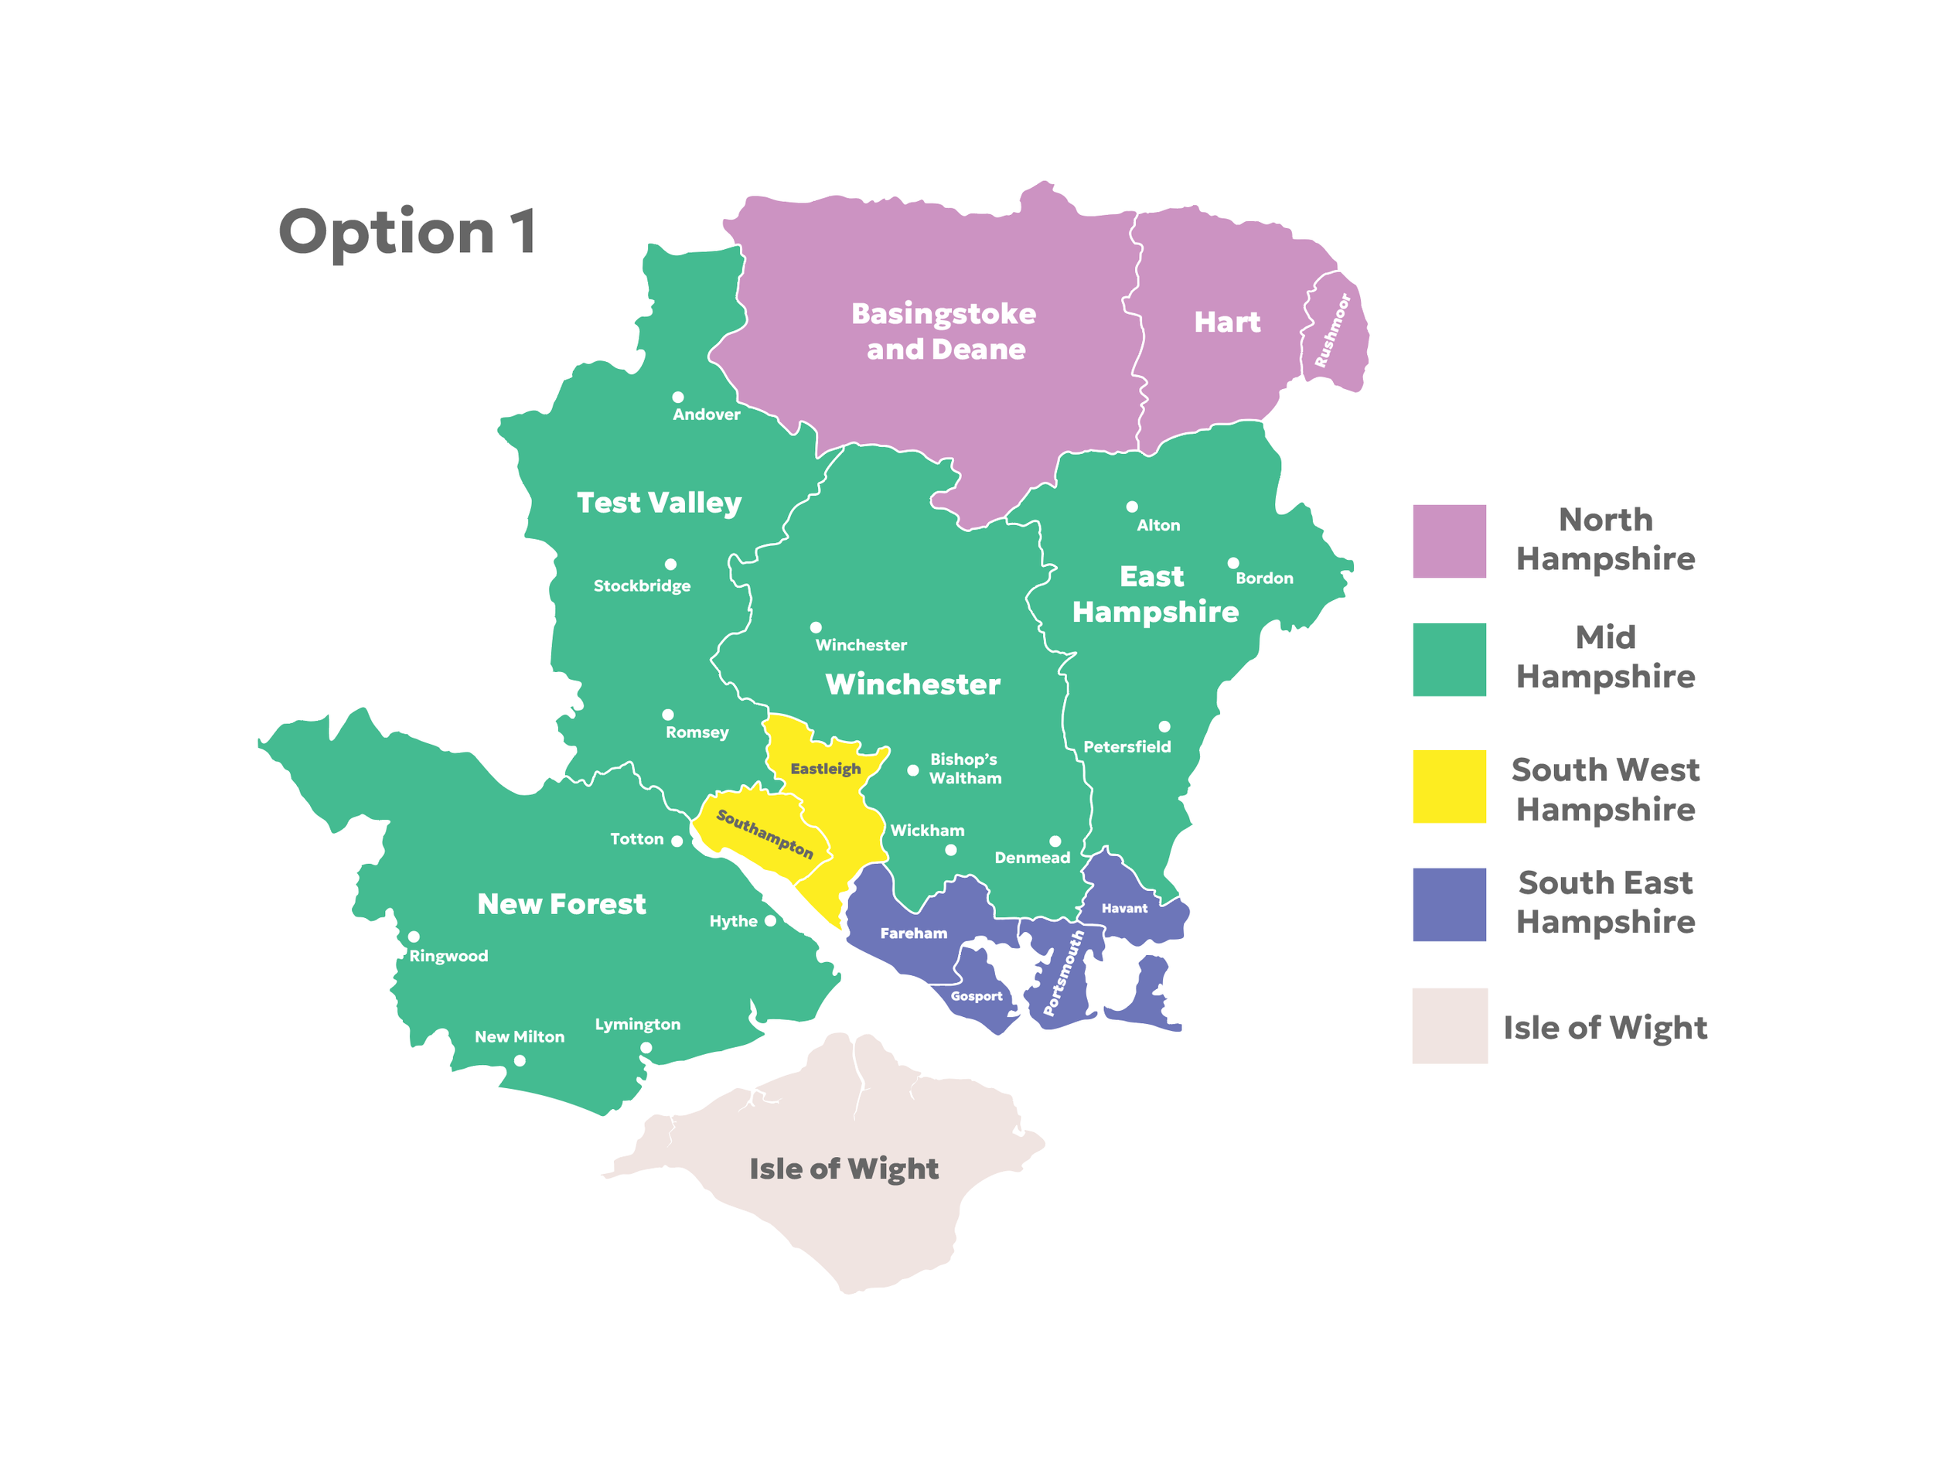


Slide 19
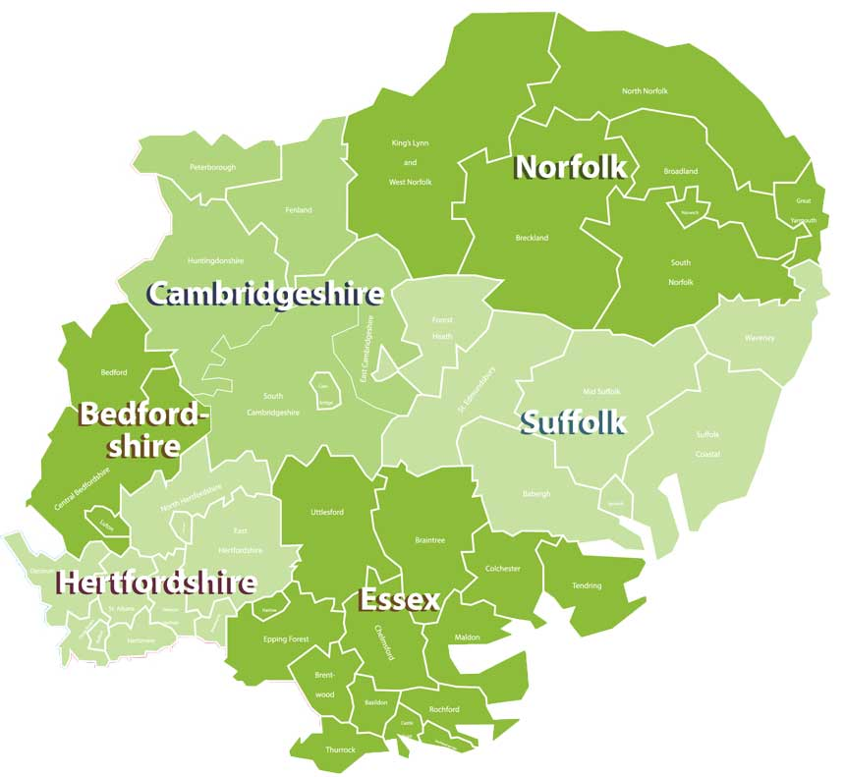
Norfolk and Suffolk
I unitary for Norfolk
2 unitary’ s for East and West Norfolk
3 unitary’ s West, Norwich (with parts of Broadland and S Norfolk)
1 unitary for Suffolk
3 unitary’ s Western (plus parts of Babergh and Mid-Suffolk) Central & Eastern (parts of Mid-Suffolk and East Suffolk) and Ipswich and Southern Suffolk

Slide 20
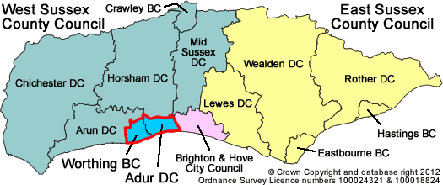
East Sussex Brighton & Hove and West Sussex
2 unitary’ s - East Sussex and Brighton
1 Unitary for West Sussex
2 unitary’ s for West Sussex
5 unitary’ s across whole area

Slide 21

The concept of under-bounding
Definition
Local government under-bounding is where a city's administrative or political boundaries are too tight and do not encompass its full, continuous urban area, economic footprint, or the surrounding communities that are functionally interdependent with the city.
Examples
Hull, Newcastle, Bristol, Nottingham, Leicester, Lincoln, Cambridge, Oxford, Southampton, Portsmouth, Derby.
Administrative areas should align, as far as feasible with the places that people live, work, and interact.

Slide 22
The consequences
Governance Challenges: The under bounded authority faces significant constraints in making strategic decisions related to planning, housing, transport, and economic growth because it must negotiate joint approaches with surrounding, independent councils. This leads to time-consuming bureaucracy and fragmented policy.
Economic and Financial Issues: A fragmented system can make it difficult to implement consistent economic policy across an entire functional economic area, potentially limiting growth and creating fiscal inequalities.
Geographic Mismatch: Critical business areas, housing developments, and essential infrastructure (like transport links or utilities) may fall into neighbouring local authorities.
Spatial Injustice: In some contexts, under bounding has been associated with boundaries being selectively drawn or expanded e.g. to exclude certain low-income, or minority neighbourhoods, leading to uneven access to essential public services..

Slide 23
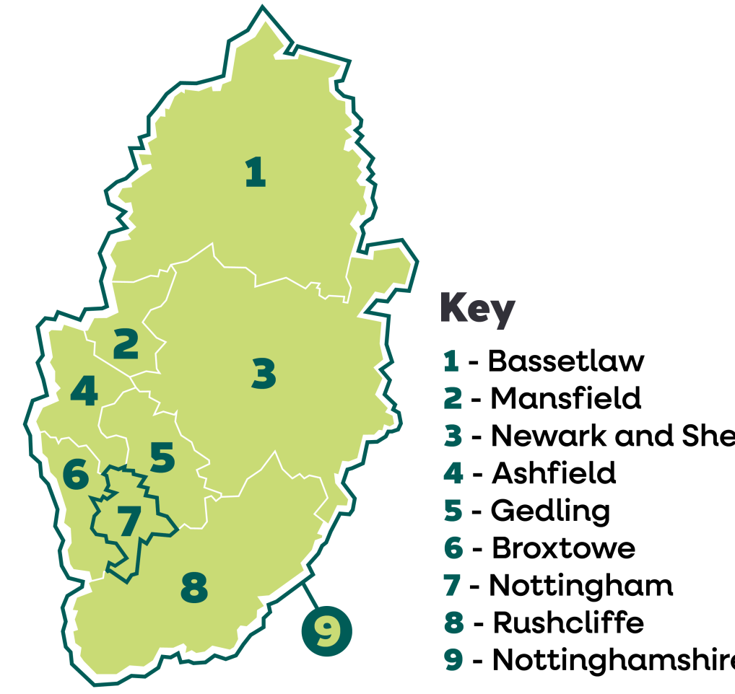
Nottingham and Nottinghamshire
Population
1. 117,400
2. 109,000
3. 122,400
4. 127,900
5. 117,900
6. 114,000
7. 332,900
8. 119,200
9. 828,200

Slide 24
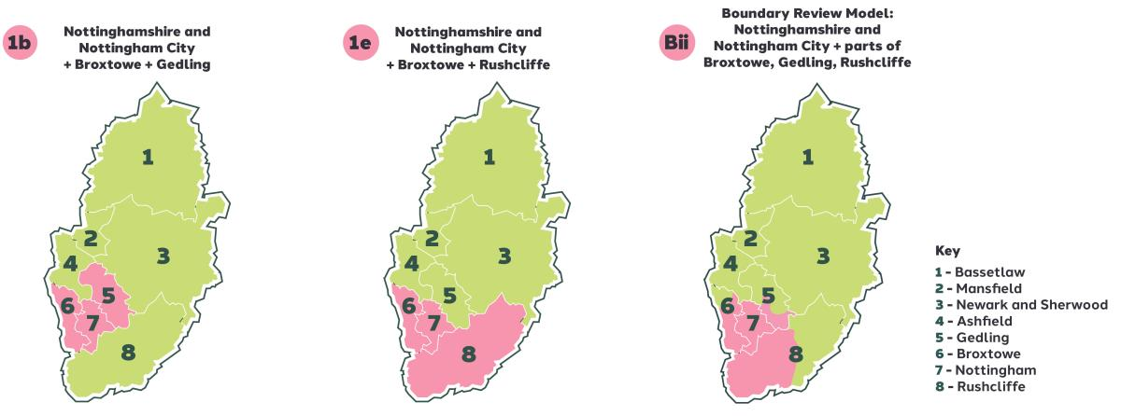
Nottingham and Nottinghamshire 3 proposals submitted to government

Slide 25
Support from Councils
Option 1b – Nottinghamshire CC and Rushcliffe BC
Option 1e –Bassetlaw DC, Gedling BC, Mansfield DC, Newark & Sherwood DC
Option Bii – Nottingham City Council
Ashfield DC resolved not to express a preference reflecting geographic economic and social distinctions within Ashfield, Nottingham and Nottinghamshire
Broxtowe BC resolved not to support any of the proposals. Agreed to submit a potential Impact assessments on Broxtowe residents – called for halt so the issues could be considered more fully.

Slide 26
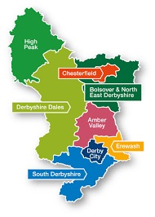
Derbyshire
I Unitary Council (Current City and County (pop 1,091,644)
2 Unitary Councils (North and South)
The 2 unitary option would split Amber Valley
North – High Peak, Derbyshire Dales, Bolsover, Chesterfield, and NE Derbyshire
South – Derby City, South Derbyshire and Erewash

Slide 27
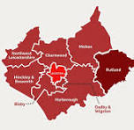
Leicester, Leicestershire and Rutland
Leicester City Council
City boundary significantly expanded to include all of Oadby and Wigston and parts of Blaby, Charnwood, Harborough.
Part of Leicestershire and Rutland
Leicestershire County Council
Single County Unitary for Leicestershire & Rutland
8 Districts and Boroughs
3 Unitary’ s - North : City : South
North includes NW Leicestershire, Charnwood, Melton and Rutland (416,000)
City (404,000)
South includes Hinckley & Bosworth, Blaby, Oadby & Wigston and Harborough (404,000)

Slide 28
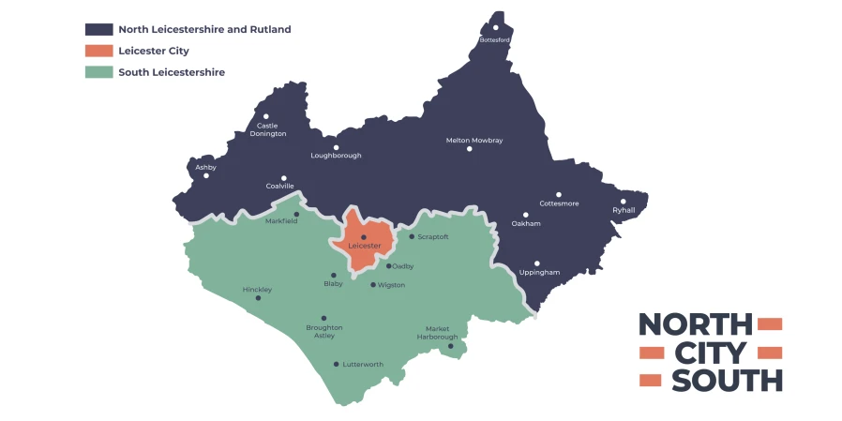
Leicestershire Districts and Rutland

Slide 29

Question or Comments

