Slide 1
From Low Skills Equilibrium to Inclusive Growth: An East Midlands Policy Perspective
Will Rossiter
william.rossiter@ntu.ac.uk

Slide 2
Skills in the East Midlands (2022)
No regional vision
Institutional fragmentation…
But interesting examples of local innovation:
NTU/Vision West Notts College – Mansfield & Ashfield
Nottingham City Tram – skills through procurement
ESF – partnership programmes – micro-credentials
Prospects - The new ‘Devo deal’ and Combined Authority

Slide 3
2006 Regional Economic Strategy
Skills challenge: “addressing the relatively high proportion of people with no qualifications and enabling more people who are in work to develop higher level skills”
“In order to raise productivity, we must also raise the skill levels of people already in employment, so action to increase the proportion of the adult workforce gaining new skills will be a priority. This will help to get more people into better jobs in growing and competitive businesses.”
“The labour market in the East Midlands is relatively stable but is characterised by the persistence of a ‘low pay low skill equilibrium’, where high employment rates are to an extent maintained by a concentration of low pay low skill jobs. The East Midlands is the only region of the five Northern and Midlands regions with an above average employment rate…The unemployment rate is relatively low… Despite this, average earnings are relatively low and there are a large number of people with no qualifications. In particular, the East Midlands significantly lags the national average in higher level qualifications, and has one of the lowest proportions of its workforce educated to degree level in the UK.”

Slide 4
RES evidence
“In the regions, the level of skill demanded by employers and the level of learning and training that takes place varies significantly. This is determined by a number of factors but of major significance are the product market strategies of the employers in the regions. The market within which the company operates, whether local, national, or international and the product market strategy, whether high value-added or low value-added, are two of the main determinants of the level of skill demanded within a company.”
“The problem in the East Midlands is not so much one of low levels of qualifications in the labour force as the low level of demand for skills from employers.”
Deindustrialisation and ‘hollowing out’ of the labour market
(Ashton & Unwin 2005)

Slide 5
‘In Demand: Adult skills in the 21st century’ Cabinet Office PIU, 2001
“For employers, [workforce] development is a derived need. They do it to enable them to achieve other objectives, notably to make a profit or deliver services. The best way to increase employer demand is by helping them to rethink their business and organisational strategies around more ambitious goals. Firms with low-cost, low added-value market strategies have little reason to value development. Organisations that resist changing their working practices find making improvements harder and harder as the gap between what they do and best practice widens.”

Slide 6
‘Atypical working in the East Midlands’ Experian 2007
Flexible workers are:
More likely to be male than female
More likely to be educated to a higher level than the average worker, particularly NVQ Level 4 and above
More likely to be aged between 35 and 54 years
More likely to work in the service sector, particularly Financial and business services and Other (mainly public) services
More likely to be employed in a managerial, professional or technical role
More likely to be located in rural Local Authority Districts (LADs) than urban local authorities in the East Midlands
We estimate that income associated with flexible working contributes between 5 and 12 per cent of GVA in the East Midlands economy.

Slide 7
EMCCA, The Mayor and Inclusive Growth
18 months in, applied for ‘established strategic authority’ status, but still ‘institution building’…
Policy outputs emerging:
RSA facilitated Inclusive Growth Commission reported September 2025
Local Growth Plan
Get East Midlands Working Plan

Slide 8
Get East Midlands Working Plan 2025
“sets out the route towards an inclusive, resilient labour market across Derby, Derbyshire, Nottingham, and Nottinghamshire, tackling persistent barriers to work while supporting inclusive economic growth…”
“We will align with our East Midlands Growth Plan to create high-paying jobs that are accessible to local people, embedding the Opportunity Escalator across both our economic and skills development programmes.”
Focus on inactivity
Tension between (IS consistent) growth opportunities identified and the accessibility imperative that is central to delivering inclusive growth

Slide 9
What does the data say?

Slide 10
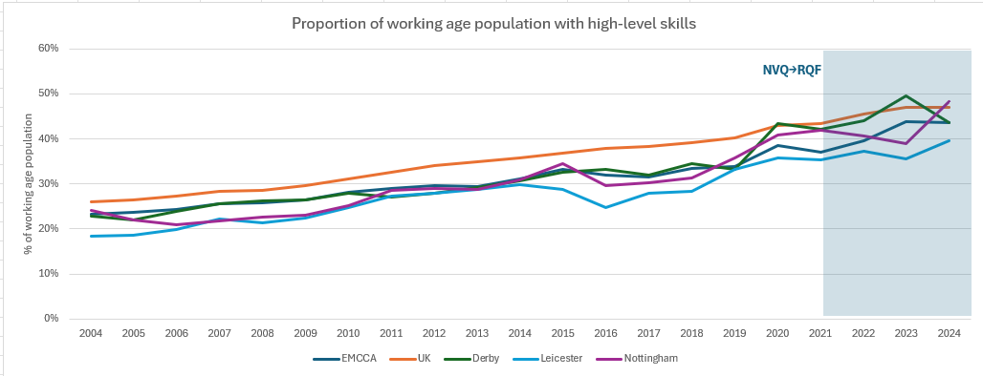
Higher level skills

Slide 11
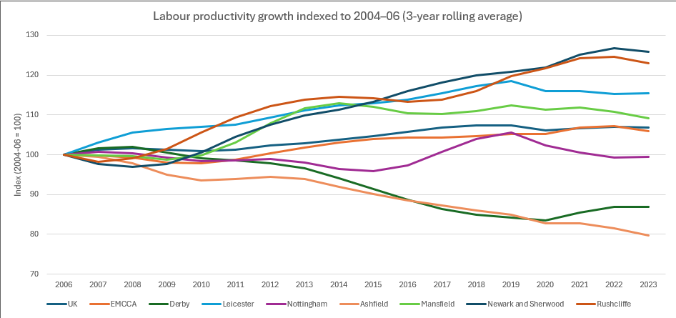
Real labour productivity
Source: ONS Subregional productivity: labour productivity indices by local authority district/NTU calculations

Slide 12
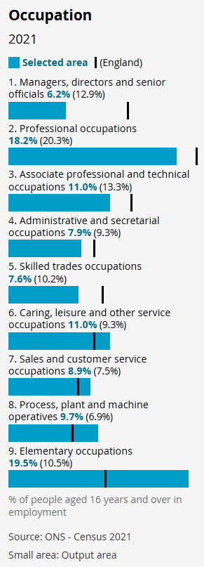
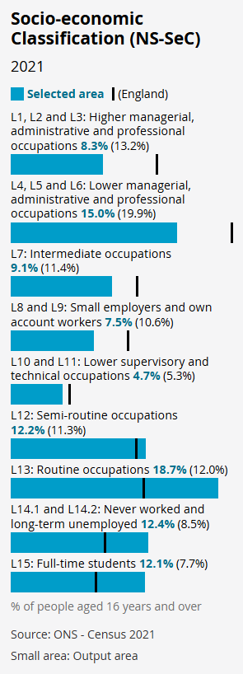
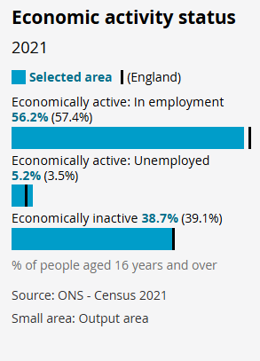
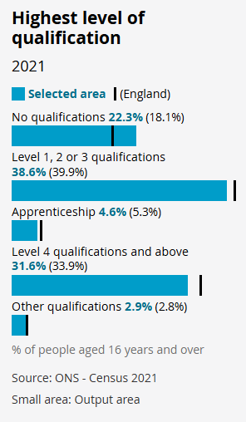
A micro view: The Meadows

Slide 13
A form of social and economic ‘lock-in’?
“Logistics! The new, post-industrial legacy of Nottinghamshire. Mines? – gone! Quarries? – filled in. Factories? – shut. Lace – Fucked! In its place – ‘emptiness’, warehouses, to store shit that gets shipped here, for us to hold it, and then ship it out, away, somewhere else. We used to make things.
Now, we just move them about.”
‘Punch’ James Graham, 2025
Based on the book ‘Right from Wrong’, Jacob Dunne 2022.

Slide 14
Implications of homeworking
Potential to address sub-regional productivity challenge?
But at risk of exacerbating existing labour market inequalities…
On policy:
Progress made on supply side
Arguably lost sight of the demand side?
The ‘opportunity escalator’ has promise – emphasising accessibility of employment
But will there be the quality employment opportunities at scale in the East Mids – without intervention on the demand side?

